Slide 1



Memory Systems Fundamentals, Recent Research, Challenges, Opportunities Lecture 3: Processing-in-Memory
Prof. Onur Mutlu
omutlu@gmail.com
https://people.inf.ethz.ch/omutlu
8 October 2018
Technion Fast Course 2018

Slide 2
Four Key Directions
Fundamentally Secure/Reliable/Safe Architectures
Fundamentally Energy-Efficient Architectures
Memory-centric (Data-centric) Architectures
Fundamentally Low-Latency Architectures
Architectures for Genomics, Medicine, Health

Slide 3
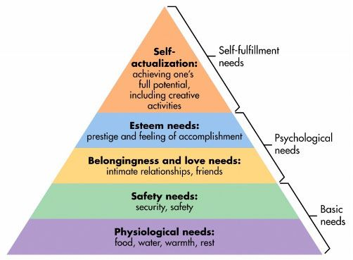
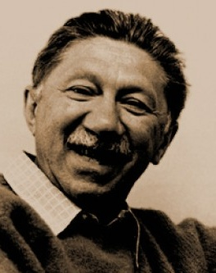
Maslow’s (Human) Hierarchy of Needs, Revisited
Maslow, “A Theory of Human Motivation,”
Psychological Review, 1943.
Maslow, “A Theory of Human Motivation,”
Psychological Review, 1943.
Maslow, “Motivation and Personality,”
Book, 1954-1970.
Everlasting energy
Source: https://www.simplypsychology.org/maslow.html

Slide 4

Do We Want This?
Source: V. Milutinovic

Slide 5
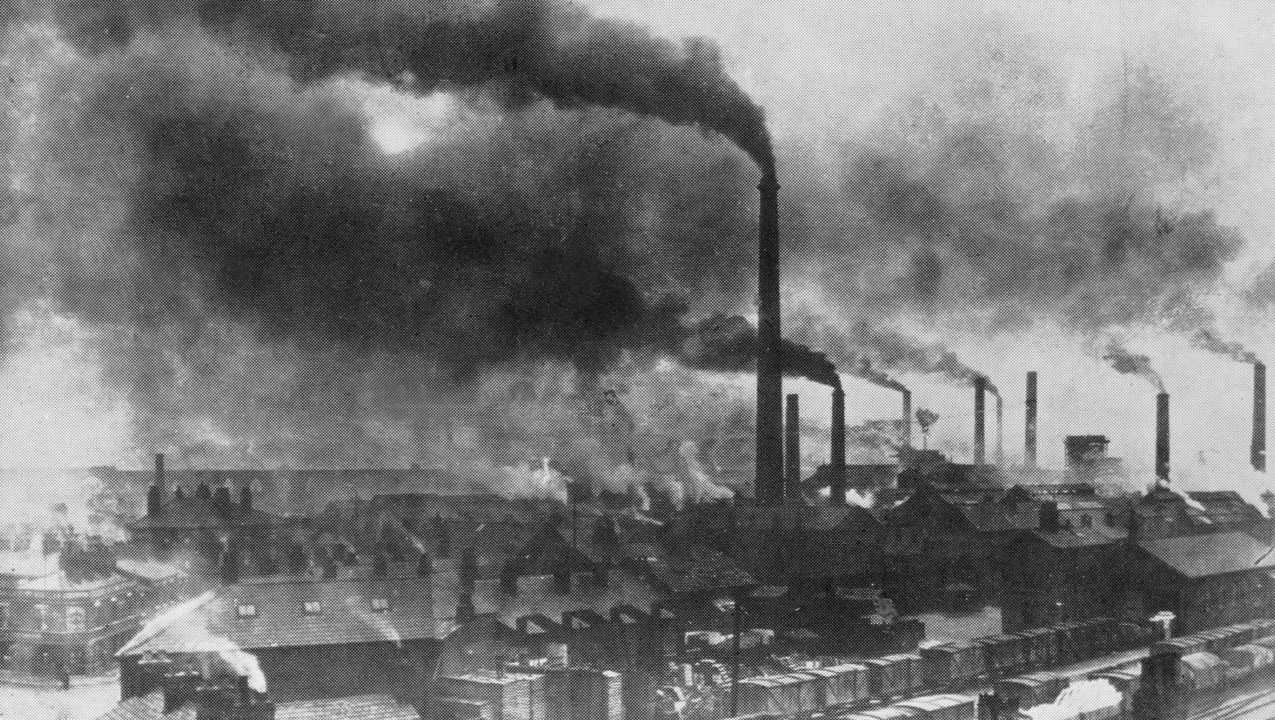
Or This?
Source: V. Milutinovic

Slide 6
Sub-Agenda: In-Memory Computation
Major Trends Affecting Main Memory
The Need for Intelligent Memory Controllers
Bottom Up: Push from Circuits and Devices
Top Down: Pull from Systems and Applications
Processing in Memory: Two Directions
Minimally Changing Memory Chips
Exploiting 3D-Stacked Memory
How to Enable Adoption of Processing in Memory
Conclusion

Slide 7
Observation and Opportunity
High latency and high energy caused by data movement
Long, energy-hungry interconnects
Energy-hungry electrical interfaces
Movement of large amounts of data
Opportunity: Minimize data movement by performing computation directly where the data resides
Processing in memory (PIM)
In-memory computation/processing
Near-data processing (NDP)
General concept applicable to any data storage & movement unit (caches, SSDs, main memory, network, controllers)

Slide 8
Three Key Systems Trends
1. Data access is a major bottleneck
Applications are increasingly data hungry
2. Energy consumption is a key limiter
3. Data movement energy dominates compute
Especially true for off-chip to on-chip movement

Slide 9




The Need for More Memory Performance
In-memory Databases
[Mao+, EuroSys’12; Clapp+ (Intel), IISWC’15]
Graph/Tree Processing
[Xu+, IISWC’12; Umuroglu+, FPL’15]
In-Memory Data Analytics
[Clapp+ (Intel), IISWC’15;
Awan+, BDCloud’15]
Datacenter Workloads [Kanev+ (Google), ISCA’15]

Slide 10
Challenge and Opportunity for Future
High Performance,
Energy Efficient,
Sustainable

Slide 11
The Problem
Data access is the major performance and energy bottleneck
Our current
design principles
cause great energy waste
(and great performance loss)

Slide 12
The Problem
Processing of data
is performed
far away from the data

Slide 13
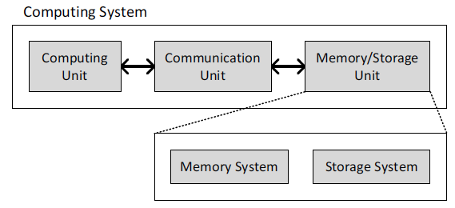
A Computing System
Three key components
Computation
Communication
Storage/memory
Burks, Goldstein, von Neumann, “Preliminary discussion of the
logical design of an electronic computing instrument,” 1946.
Image source: https://lbsitbytes2010.wordpress.com/2013/03/29/john-von-neumann-roll-no-15/

Slide 14
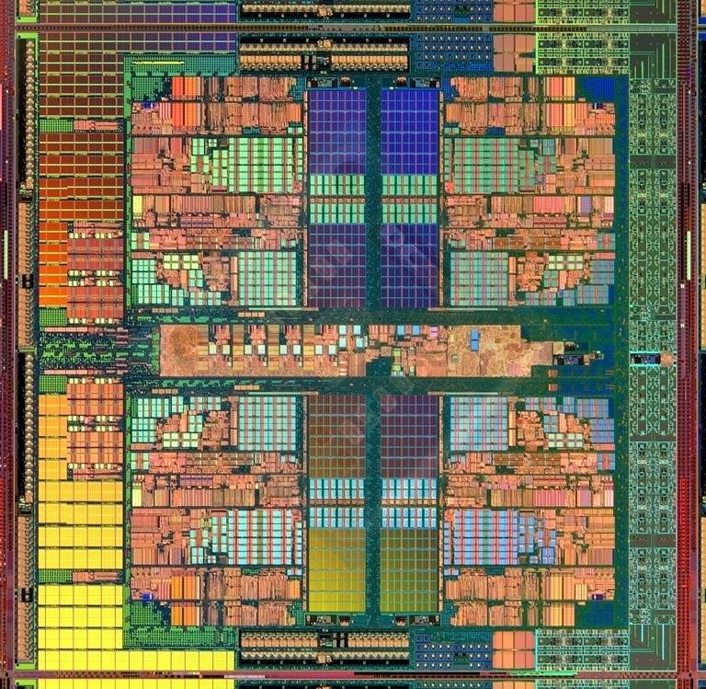
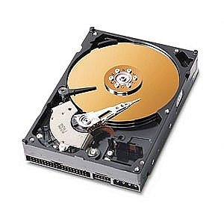
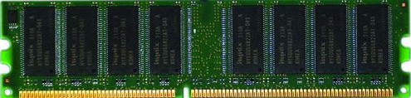
A Computing System
Three key components
Computation
Communication
Storage/memory
Burks, Goldstein, von Neumann, “Preliminary discussion of the
logical design of an electronic computing instrument,” 1946.
Image source: https://lbsitbytes2010.wordpress.com/2013/03/29/john-von-neumann-roll-no-15/

Slide 15
Today’s Computing Systems
Are overwhelmingly processor centric
All data processed in the processor → at great system cost
Processor is heavily optimized and is considered the master
Data storage units are dumb and are largely unoptimized (except for some that are on the processor die)

Slide 16
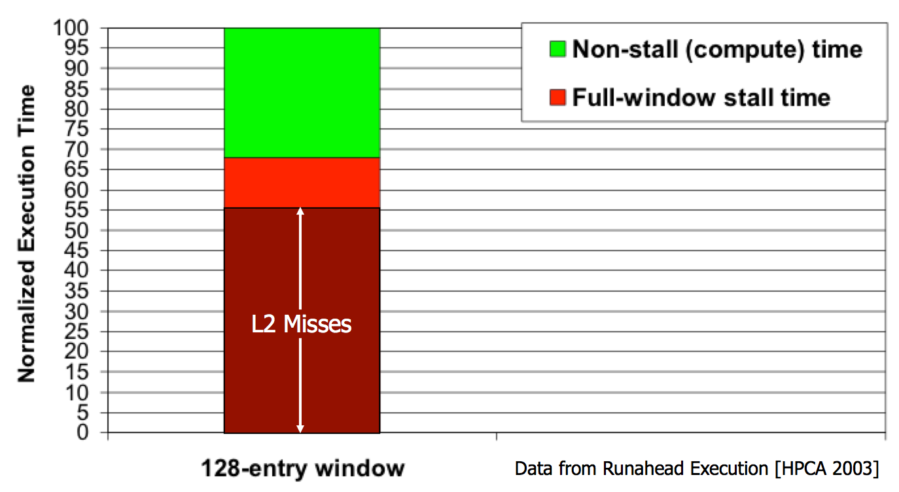
Yet …
“It’s the Memory, Stupid!” (Richard Sites, MPR, 1996)
Mutlu+, “Runahead Execution: An Alternative to Very Large Instruction Windows for Out-of-Order Processors,” HPCA 2003.

Slide 17
The Performance Perspective
Onur Mutlu, Jared Stark, Chris Wilkerson, and Yale N. Patt, "Runahead Execution: An Alternative to Very Large Instruction Windows for Out-of-order Processors" Proceedings of the 9th International Symposium on High-Performance Computer Architecture (HPCA), pages 129-140, Anaheim, CA, February 2003. Slides (pdf)

Slide 18
The Performance Perspective (Today)
All of Google’s Data Center Workloads (2015):
Kanev+, “Profiling a Warehouse-Scale Computer,” ISCA 2015.

Slide 19
The Performance Perspective (Today)
All of Google’s Data Center Workloads (2015):
Kanev+, “Profiling a Warehouse-Scale Computer,” ISCA 2015.

Slide 20
Perils of Processor-Centric Design
Grossly-imbalanced systems
Processing done only in one place
Everything else just stores and moves data: data moves a lot
→ Energy inefficient
→ Low performance
→ Complex
Overly complex and bloated processor (and accelerators)
To tolerate data access from memory
Complex hierarchies and mechanisms
→ Energy inefficient
→ Low performance
→ Complex

Slide 21
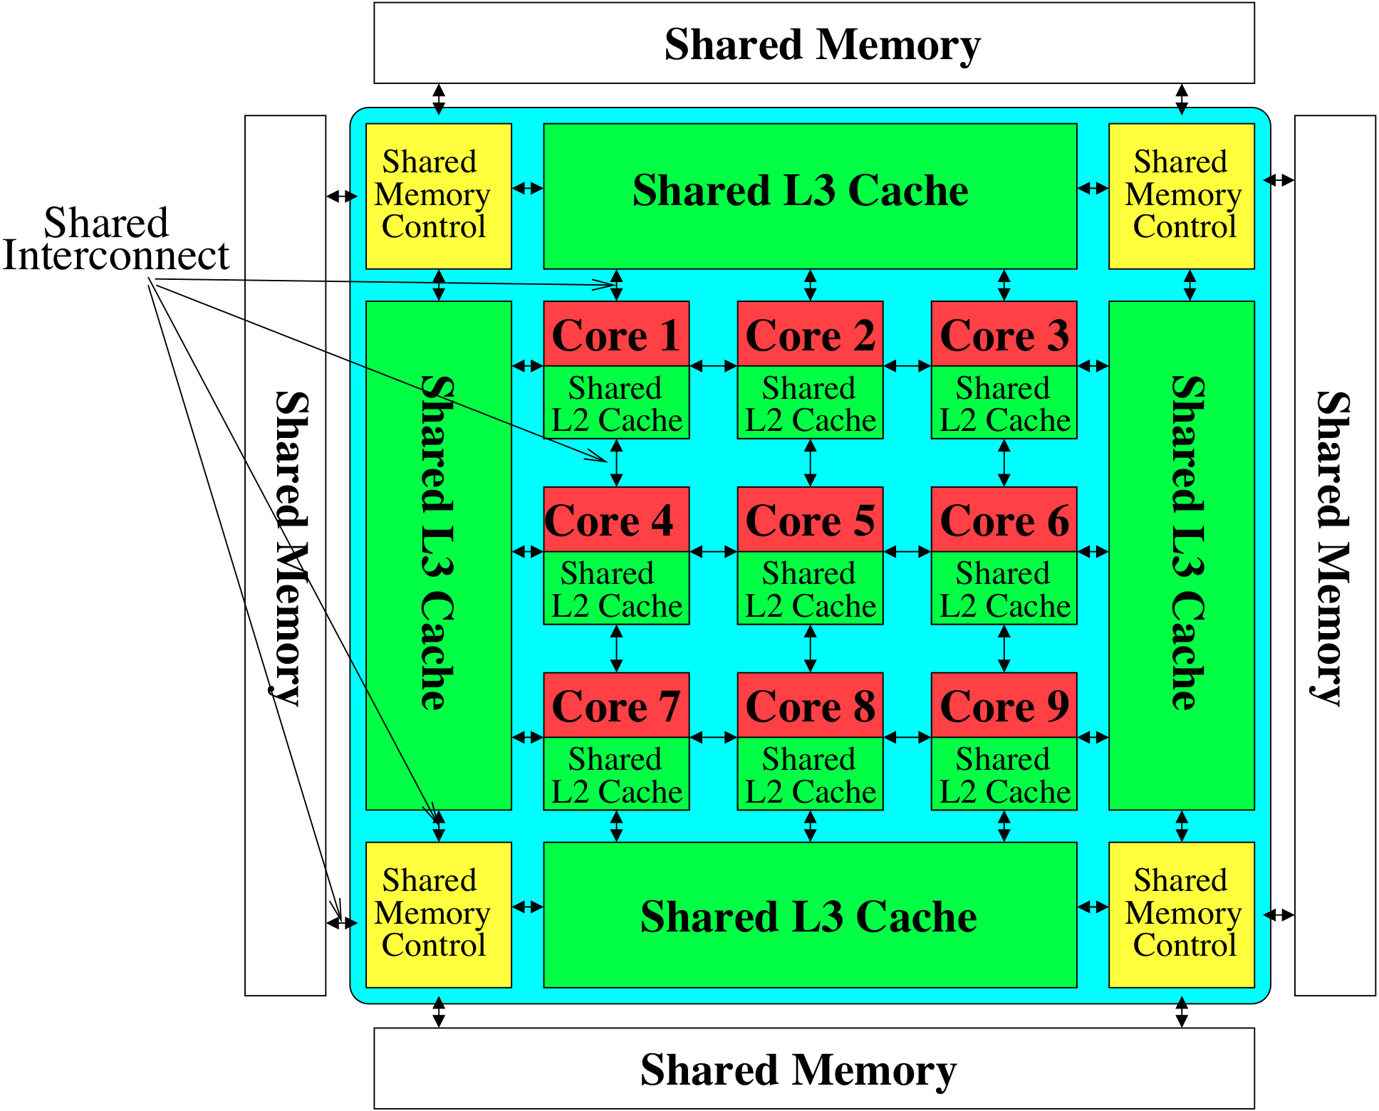
Perils of Processor-Centric Design
Most of the system is dedicated to storing and moving data

Slide 22
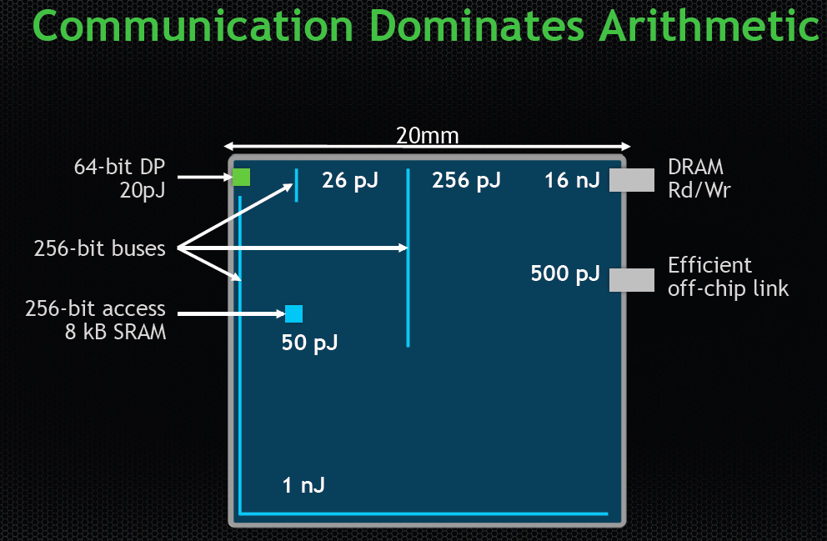
The Energy Perspective
Dally, HiPEAC 2015

Slide 23
Data Movement vs. Computation Energy
Dally, HiPEAC 2015
A memory access consumes ~1000X
the energy of a complex addition

Slide 24
Data Movement vs. Computation Energy
Data movement is a major system energy bottleneck
Comprises 41% of mobile system energy during web browsing [2]
Costs ~115 times as much energy as an ADD operation [1, 2]
[1]: Reducing data Movement Energy via Online Data Clustering and Encoding (MICRO’16)
[2]: Quantifying the energy cost of data movement for emerging smart phone workloads on mobile platforms (IISWC’14)

Slide 25
Energy Waste in Mobile Devices
Amirali Boroumand, Saugata Ghose, Youngsok Kim, Rachata Ausavarungnirun, Eric Shiu, Rahul Thakur, Daehyun Kim, Aki Kuusela, Allan Knies, Parthasarathy Ranganathan, and Onur Mutlu, "Google Workloads for Consumer Devices: Mitigating Data Movement Bottlenecks" Proceedings of the 23rd International Conference on Architectural Support for Programming Languages and Operating Systems (ASPLOS), Williamsburg, VA, USA, March 2018.
62.7% of the total system energy
is spent on data movement

Slide 26
We Do Not Want to Move Data!
Dally, HiPEAC 2015
A memory access consumes ~1000X
the energy of a complex addition

Slide 27
We Need A Paradigm Shift To …
Enable computation with minimal data movement
Compute where it makes sense (where data resides)
Make computing architectures more data-centric

Slide 28
Goal: Processing Inside Memory
Many questions … How do we design the:
compute-capable memory & controllers?
processor chip and in-memory units?
software and hardware interfaces?
system software and languages?
algorithms?
Memory
Processor
Core
Database
Graphs
Media
Cache
Query
Interconnect
Problem
Results
Algorithm
Program/Language
System Software
SW/HW Interface
Micro-architecture
Logic
Devices
Electrons

Slide 29
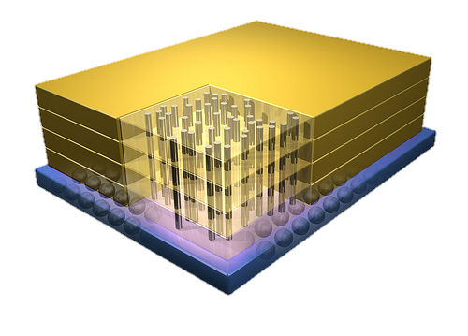


Why In-Memory Computation Today?
Dally, HiPEAC 2015
Push from Technology
DRAM Scaling at jeopardy
→ Controllers close to DRAM
→ Industry open to new memory architectures
Pull from Systems and Applications
Data access is a major system and application bottleneck
Systems are energy limited
Data movement much more energy-hungry than computation

Slide 30
Agenda
Major Trends Affecting Main Memory
The Need for Intelligent Memory Controllers
Bottom Up: Push from Circuits and Devices
Top Down: Pull from Systems and Applications
Processing in Memory: Two Directions
Minimally Changing Memory Chips
Exploiting 3D-Stacked Memory
How to Enable Adoption of Processing in Memory
Conclusion

Slide 31
Processing in Memory: Two Approaches
1. Minimally changing memory chips
2. Exploiting 3D-stacked memory

Slide 32
Approach 1: Minimally Changing DRAM
DRAM has great capability to perform bulk data movement and computation internally with small changes
Can exploit internal connectivity to move data
Can exploit analog computation capability
…
Examples: RowClone, In-DRAM AND/OR, Gather/Scatter DRAM
RowClone: Fast and Efficient In-DRAM Copy and Initialization of Bulk Data (Seshadri et al., MICRO 2013)
Fast Bulk Bitwise AND and OR in DRAM (Seshadri et al., IEEE CAL 2015)
Gather-Scatter DRAM: In-DRAM Address Translation to Improve the Spatial Locality of Non-unit Strided Accesses (Seshadri et al., MICRO 2015)
"Ambit: In-Memory Accelerator for Bulk Bitwise Operations Using Commodity DRAM Technology” (Seshadri et al., MICRO 2017)

Slide 33
Starting Simple: Data Copy and Initialization
Bulk Data Copy
src
dst
Bulk Data Initialization
dst
val

Slide 34
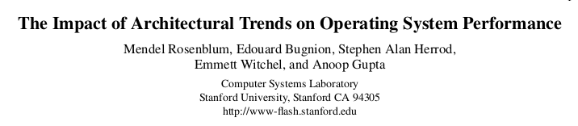
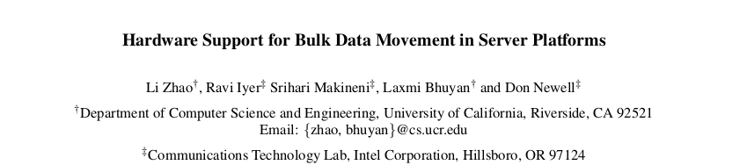
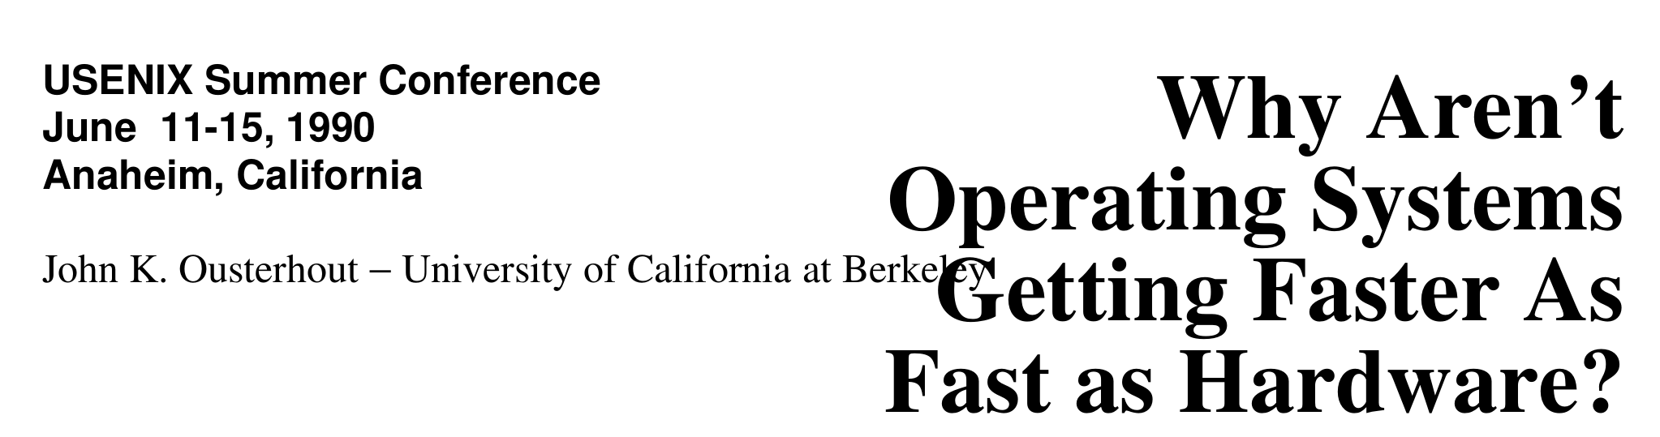
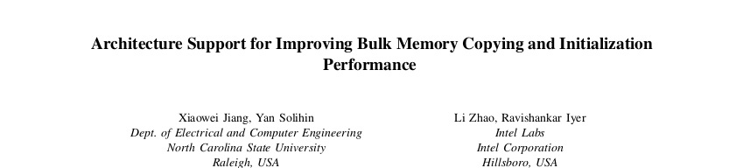
Bulk Data Copy and Initialization
Bulk Data Copy
src
dst
Bulk Data Initialization
dst
val

Slide 35

Starting Simple: Data Copy and Initialization
memmove & memcpy: 5% cycles in Google’s datacenter [Kanev+ ISCA’15]
000000000000000
Zero initialization
(e.g., security)
Forking
Checkpointing
Many more
VM Cloning
Deduplication
Page Migration

Slide 36
Today’s Systems: Bulk Data Copy
1) High latency
Memory
3) Cache pollution
L3
CPU
L2
L1
MC
2) High bandwidth utilization
4) Unwanted data movement
1046ns, 3.6uJ (for 4KB page copy via DMA)

Slide 37
Future Systems: In-Memory Copy
3) No cache pollution
1) Low latency
Memory
L3
CPU
L2
L1
MC
2) Low bandwidth utilization
4) No unwanted data movement
1046ns, 3.6uJ
→ 90ns, 0.04uJ

Slide 38
RowClone: In-DRAM Row Copy
Idea: Two consecutive ACTivates
4 Kbytes
Negligible HW cost
Step 1: Activate row A
Step 2: Activate row B
Transfer row
DRAM subarray
Transfer
row
Row Buffer (4 Kbytes)
8 bits
Data Bus
Notes:
copy

Slide 39
RowClone: Intra-Subarray
V_{DD}
V_{DD}/2 + δ
V_{DD}
V_{DD}/2
V_{DD}/2 + δ
src
0
dst
0
Amplify the difference
Data gets copied
Sense Amplifier
(Row Buffer)
V_{DD}/2
0

Slide 40
RowClone: Intra-Subarray (II)
s
r
c
r
o
w
s
d
s
r
c
t
r
r
o
o
w
w
s
r
c
r
o
w
Row Buffer
1. Activate src row (copy data from src to row buffer)
2. Activate dst row (disconnect src from row buffer, connect dst – copy data from row buffer to dst)

Slide 41
RowClone: Inter-Bank
Chip I/O
Bank
Shared internal bus
Memory Channel
Overlap the latency of the read and the write
1.9X latency reduction, 3.2X energy reduction

Slide 42
Generalized RowClone
0.01% area cost
Inter Subarray Copy
(Use Inter-Bank Copy Twice)
Subarray
Chip I/O
Bank
Bank I/O
Memory Channel
Inter Bank Copy
(Pipelined
Internal RD/WR)
Intra Subarray
Copy (2 ACTs)

Slide 43
RowClone: Fast Row Initialization
0
0
0
0
0
0
0
0
0
0
0
0
Fix a row at Zero
(0.5% loss in capacity)

Slide 44
RowClone: Bulk Initialization
Initialization with arbitrary data
Initialize one row
Copy the data to other rows
Zero initialization (most common)
Reserve a row in each subarray (always zero)
Copy data from reserved row (FPM mode)
6.0X lower latency, 41.5X lower DRAM energy
0.2% loss in capacity

Slide 45
RowClone: Latency & Energy Benefits
74.4x
11.6x
41.5x
6.0x
1.9x
1.0x
3.2x
1.5x
Very low cost: 0.01% increase in die area

Slide 46
Copy and Initialization in Workloads

Slide 47
RowClone: Application Performance

Slide 48
End-to-End System Design
Application
How to communicate occurrences of bulk copy/initialization across layers?
Operating System
How to ensure cache coherence?
ISA
Microarchitecture
How to maximize latency and energy savings?
DRAM (RowClone)
How to handle data reuse?

Slide 49
RowClone: Latency and Energy Savings
11.6x
74x
Seshadri et al., “RowClone: Fast and Efficient In-DRAM Copy and Initialization of Bulk Data,” MICRO 2013.

Slide 50
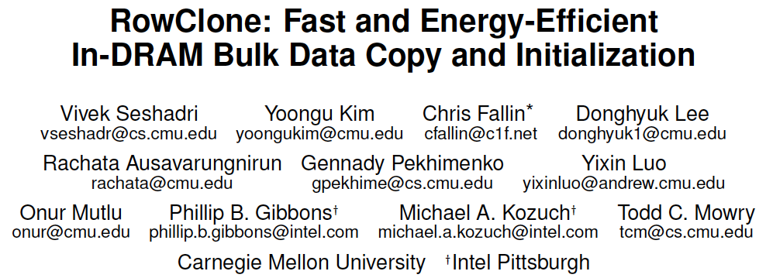
More on RowClone
Vivek Seshadri, Yoongu Kim, Chris Fallin, Donghyuk Lee, Rachata Ausavarungnirun, Gennady Pekhimenko, Yixin Luo, Onur Mutlu, Michael A. Kozuch, Phillip B. Gibbons, and Todd C. Mowry, "RowClone: Fast and Energy-Efficient In-DRAM Bulk Data Copy and Initialization" Proceedings of the 46th International Symposium on Microarchitecture (MICRO), Davis, CA, December 2013. [Slides (pptx) (pdf)] [Lightning Session Slides (pptx) (pdf)] [Poster (pptx) (pdf)]

Slide 51
Memory as an Accelerator
CPU
core
CPU
core
mini-CPU
core
GPU
(throughput)
core
GPU
(throughput)
core
video
core
GPU
(throughput)
core
GPU
(throughput)
core
CPU
core
CPU
core
Memory
imaging
core
LLC
Specialized
compute-capability
in memory
Memory Controller
Memory Bus
Memory similar to a “conventional” accelerator

Slide 52
In-Memory Bulk Bitwise Operations
We can support in-DRAM COPY, ZERO, AND, OR, NOT, MAJ
At low cost
Using analog computation capability of DRAM
Idea: activating multiple rows performs computation
30-60X performance and energy improvement
Seshadri+, “Ambit: In-Memory Accelerator for Bulk Bitwise Operations Using Commodity DRAM Technology,” MICRO 2017.
New memory technologies enable even more opportunities
Memristors, resistive RAM, phase change mem, STT-MRAM, …
Can operate on data with minimal movement

Slide 53
In-DRAM AND/OR: Triple Row Activation
½V_{DD}
½V_{DD}+δ
V_{DD}
A
Final State
AB + BC + AC
B
C
C(A + B) + ~C(AB)
dis
en
0
½V_{DD}
Seshadri+, “Fast Bulk Bitwise AND and OR in DRAM”, IEEE CAL 2015.

Slide 54
In-DRAM Bulk Bitwise AND/OR Operation
BULKAND A, B → C
Semantics: Perform a bitwise AND of two rows A and B and store the result in row C
R0 – reserved zero row, R1 – reserved one row
D1, D2, D3 – Designated rows for triple activation
1. RowClone A into D1
2. RowClone B into D2
3. RowClone R0 into D3
4. ACTIVATE D1,D2,D3
5. RowClone Result into C

Slide 55
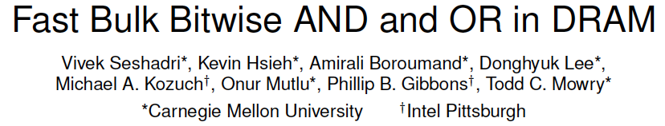
More on In-DRAM Bulk AND/OR
Vivek Seshadri, Kevin Hsieh, Amirali Boroumand, Donghyuk Lee, Michael A. Kozuch, Onur Mutlu, Phillip B. Gibbons, and Todd C. Mowry, "Fast Bulk Bitwise AND and OR in DRAM" IEEE Computer Architecture Letters (CAL), April 2015.

Slide 56
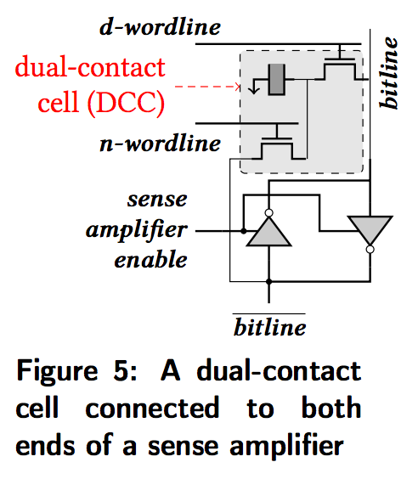
In-DRAM NOT: Dual Contact Cell
Idea:
Feed the
negated value
in the sense amplifier
into a special row
Seshadri+, “Ambit: In-Memory Accelerator for Bulk Bitwise Operations using Commodity DRAM Technology,” MICRO 2017.

Slide 57
In-DRAM NOT Operation
Seshadri+, “Ambit: In-Memory Accelerator for Bulk Bitwise Operations using Commodity DRAM Technology,” MICRO 2017.

Slide 58
Performance: In-DRAM Bitwise Operations
Seshadri+, “Ambit: In-Memory Accelerator for Bulk Bitwise Operations using Commodity DRAM Technology,” MICRO 2017.

Slide 59
Energy of In-DRAM Bitwise Operations
Seshadri+, “Ambit: In-Memory Accelerator for Bulk Bitwise Operations using Commodity DRAM Technology,” MICRO 2017.

Slide 60
Ambit vs. DDR3: Performance and Energy
32X
35X
Seshadri+, “Ambit: In-Memory Accelerator for Bulk Bitwise Operations using Commodity DRAM Technology,” MICRO 2017.

Slide 61
Bulk Bitwise Operations in Workloads
[1] Li and Patel, BitWeaving, SIGMOD 2013
[2] Goodwin+, BitFunnel, SIGIR 2017

Slide 62
Example Data Structure: Bitmap Index
Alternative to B-tree and its variants
Efficient for performing range queries and joins
Many bitwise operations to perform a query
age < 18
18 < age < 25
25 < age < 60
age > 60
Bitmap 1
Bitmap 2
Bitmap 3
Bitmap 4

Slide 63
Performance: Bitmap Index on Ambit
Seshadri+, “Ambit: In-Memory Accelerator for Bulk Bitwise Operations using Commodity DRAM Technology,” MICRO 2017.

Slide 64
Performance: BitWeaving on Ambit
Seshadri+, “Ambit: In-Memory Accelerator for Bulk Bitwise Operations using Commodity DRAM Technology,” MICRO 2017.

Slide 65
More on In-DRAM Bulk AND/OR
Vivek Seshadri, Kevin Hsieh, Amirali Boroumand, Donghyuk Lee, Michael A. Kozuch, Onur Mutlu, Phillip B. Gibbons, and Todd C. Mowry, "Fast Bulk Bitwise AND and OR in DRAM" IEEE Computer Architecture Letters (CAL), April 2015.

Slide 66
More on Ambit
Vivek Seshadri et al., “Ambit: In-Memory Accelerator for Bulk Bitwise Operations Using Commodity DRAM Technology,” MICRO 2017.

Slide 67
Challenge and Opportunity for Future
Computing Architectures
with
Minimal Data Movement

Slide 68
Challenge: Intelligent Memory Device
Does memory
have to be
dumb?

Slide 69
Agenda
Major Trends Affecting Main Memory
The Need for Intelligent Memory Controllers
Bottom Up: Push from Circuits and Devices
Top Down: Pull from Systems and Applications
Processing in Memory: Two Directions
Minimally Changing Memory Chips
Exploiting 3D-Stacked Memory
How to Enable Adoption of Processing in Memory
Conclusion

Slide 70
Processing in Memory: Two Approaches
1. Minimally changing memory chips
2. Exploiting 3D-stacked memory

Slide 71
Opportunity: 3D-Stacked Logic+Memory
Memory
Logic
Other “True 3D” technologies
under development

Slide 72
DRAM Landscape (circa 2015)
Kim+, “Ramulator: A Flexible and Extensible DRAM Simulator”, IEEE CAL 2015.

Slide 73
Two Key Questions in 3D-Stacked PIM
How can we accelerate important applications if we use 3D-stacked memory as a coarse-grained accelerator?
what is the architecture and programming model?
what are the mechanisms for acceleration?
What is the minimal processing-in-memory support we can provide?
without changing the system significantly
while achieving significant benefits

Slide 74




Graph Processing
Large graphs are everywhere (circa 2015)
Scalable large-scale graph processing is challenging
36 Million
Wikipedia Pages
1.4 Billion
Facebook Users
300 Million
Twitter Users
30 Billion
Instagram Photos

Slide 75
Key Bottlenecks in Graph Processing
for (v: graph.vertices) {
for (w: v.successors) {
w.next_rank += weight * v.rank;
}
}
1. Frequent random memory accesses
v
&w
w.rank
w.next_rank
w.edges
weight * v.rank
w
…
2. Little amount of computation

Slide 76
Tesseract System for Graph Processing
Interconnected set of 3D-stacked memory+logic chips with simple cores
Host Processor
Memory
Memory-Mapped
Accelerator Interface
(Noncacheable, Physically Addressed)
Logic
In-Order Core
DRAM Controller
…
…
LP
PF Buffer
Crossbar Network
…
MTP
…
Message Queue
NI
Ahn+, “A Scalable Processing-in-Memory Accelerator for Parallel Graph Processing” ISCA 2015.

Slide 77
Tesseract System for Graph Processing
Host Processor
Memory
Memory-Mapped
Accelerator Interface
(Noncacheable, Physically Addressed)
Logic
In-Order Core
DRAM Controller
…
…
Communications via Remote Function Calls
LP
PF Buffer
Crossbar Network
…
MTP
…
Message Queue
NI

Slide 78
Communications In Tesseract (I)

Slide 79
Communications In Tesseract (II)

Slide 80
Communications In Tesseract (III)

Slide 81
Remote Function Call (Non-Blocking)

Slide 82
Tesseract System for Graph Processing
Host Processor
Memory
Memory-Mapped
Accelerator Interface
(Noncacheable, Physically Addressed)
Logic
Prefetching
In-Order Core
DRAM Controller
…
…
LP
PF Buffer
Crossbar Network
…
MTP
…
Message Queue
NI

Slide 83
Evaluated Systems
DDR3-OoO
HMC-OoO
HMC-MC
Tesseract
32 Tesseract Cores
8 OoO
4GHz
8 OoO
4GHz
8 OoO
4GHz
8 OoO
4GHz
128 In-Order
2GHz
128 In-Order
2GHz
8 OoO
4GHz
8 OoO
4GHz
8 OoO
4GHz
8 OoO
4GHz
128 In-Order
2GHz
128 In-Order
2GHz
102.4GB/s
640GB/s
640GB/s
8TB/s
Ahn+, “A Scalable Processing-in-Memory Accelerator for Parallel Graph Processing” ISCA 2015.

Slide 84
Tesseract Graph Processing Performance
>13X Performance Improvement
On five graph processing algorithms
Ahn+, “A Scalable Processing-in-Memory Accelerator for Parallel Graph Processing” ISCA 2015.

Slide 85
Tesseract Graph Processing Performance

Slide 86
Effect of Bandwidth & Programming Model
HMC-MC Bandwidth (640GB/s)
Tesseract Bandwidth (8TB/s)
Programming Model
Bandwidth
(No Prefetching)

Slide 87
Tesseract Graph Processing System Energy
> 8X Energy Reduction
Ahn+, “A Scalable Processing-in-Memory Accelerator for Parallel Graph Processing” ISCA 2015.

Slide 88
Tesseract: Advantages & Disadvantages
Advantages
+ Specialized graph processing accelerator using PIM
+ Large system performance and energy benefits
+ Takes advantage of 3D stacking for an important workload
Disadvantages
- Changes a lot in the system
- New programming model
- Specialized Tesseract cores for graph processing
- Cost
- Scalability limited by off-chip links or graph partitioning

Slide 89
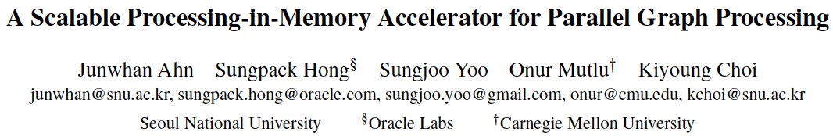
More on Tesseract
Junwhan Ahn, Sungpack Hong, Sungjoo Yoo, Onur Mutlu, and Kiyoung Choi, "A Scalable Processing-in-Memory Accelerator for Parallel Graph Processing" Proceedings of the 42nd International Symposium on Computer Architecture (ISCA), Portland, OR, June 2015. [Slides (pdf)] [Lightning Session Slides (pdf)]

Slide 90
3D-Stacked PIM on Mobile Devices
Amirali Boroumand, Saugata Ghose, Youngsok Kim, Rachata Ausavarungnirun, Eric Shiu, Rahul Thakur, Daehyun Kim, Aki Kuusela, Allan Knies, Parthasarathy Ranganathan, and Onur Mutlu, "Google Workloads for Consumer Devices: Mitigating Data Movement Bottlenecks" Proceedings of the 23rd International Conference on Architectural Support for Programming Languages and Operating Systems (ASPLOS), Williamsburg, VA, USA, March 2018.

Slide 91





Google Workloads for Consumer Devices: Mitigating Data Movement Bottlenecks
Amirali Boroumand
Saugata Ghose, Youngsok Kim, Rachata Ausavarungnirun,
Eric Shiu, Rahul Thakur, Daehyun Kim, Aki Kuusela, Allan Knies, Parthasarathy Ranganathan, Onur Mutlu

Slide 92




Consumer Devices
Consumer devices are everywhere!
Energy consumption is a first-class concern in consumer devices
Notes:
Consumer devices like tablets smartphone and wearable are now everywhere and used by billions of people.
One of the major challenge in these devices is battery limitation which makes the energy consumption a critical concern …

Slide 93





Popular Google Consumer Workloads
Chrome
TensorFlow Mobile
Google’s web browser
Google’s machine learning framework
Video Playback
Video Capture
Google’s video codec
Google’s video codec
Notes:
In this work, we take a look at widely-used google consumer workloads, to figure out the major sources of energy consumption.
We look at Google Chrome web brower. We take a look at Tensorflow, Google’s machine learning framework, and we also take a look at two important video related workloads, video playback and video capture, both rely on Google’s vp9 codec technology.

Slide 94
Energy Cost of Data Movement
1st key observation: 62.7% of the total system energy is spent on data movement
Data Movement
SoC
DRAM
CPU
L2
CPU
L1
CPU
CPU
Compute Unit
Processing-In-Memory (PIM)
Potential solution: move computation close to data
Challenge: limited area and energy budget
Notes:
Throughout our analysis, we make a key observation that out of all sources of energy consumption, data movement is a major contributor to the total system energy. We find that across all of the workloads, on average around 62.7% of total system energy is spent on data movement.
One way to reduce data movement cost is to move computation close to data, or …
One potential solution to address this cost it do move computation close to data, or in other words, do procesing in memory. However, the challenge is that these devices.
One potential solution to mitigate data movement cost and reduce total system energy is to execute data-movement heavy portions of application close to data, or in other words, do processing in memory. However, consumer devices are extermely limited in terms of area and power budget. So the question is can we move part of the data movement heavy portion given the limited area and energy budget. Our

Slide 95
Using PIM to Reduce Data Movement
2nd key observation: a significant fraction of the data movement often comes from simple functions
We can design lightweight logic to implement these simple functions in memory
Small embedded low-power core
Small fixed-function accelerators
PIM Core
PIM Accelerator
PIM Accelerator
PIM Accelerator
Offloading to PIM logic reduces energy and improves performance, on average, by 55.4% and 54.2%
Notes:
To figure out if we can use processing in memory, we dig deeper into our analysis and we make another key observation that majority of data movement often comes form simple functions and pritmitives. We find that these simple function can be implemented in memory as either a small embedded core, or group of small fixed function accelerators. Our result shows that offloading these function to PIM logic can significantly reduce data movement for each function and reduce energy on average around 55% and improve perforamcne around 54%.
our PIM core can reduce significant portion of data movement, reduce enregy by 49.1% for each function and improve performance up to 2.2X. While using group of fixed function accelerator reduce energy by 55.4% and improve performance by up to 2.5X.
Or use Saugata’s approach : Reduces total system energy by an average of 55.4%
Reduces execution time by an average of 54.2%
Our result show that both of them can significantly reduce the data movement for each function.
Feedback: talk about result more
Don’t talk about specific detail like MemCopy, MemSet stuff like that
Main take away: data movement come from simple functions that are simple enough to implement in PIM
We find that these functions and primitves can be implemented as PIM logic using either (1) a small low-power general-purpose embedded core or (2) a group of small fixed-function accelerators (PIM accelerators). Our Analysis shows that both are cost-feasible to use in consumer devices. We find that they eliminate a significant fraction of dat amovement, and reduce energy consumption for each of these operation on average by 49 and 55%.

Slide 96
Workload Analysis
Chrome
TensorFlow Mobile
Google’s web browser
Google’s machine learning framework
Video Playback
Video Capture
Google’s video codec
Google’s video codec
Notes:
In this work, we take a look at widely-used google consumer workloads, to figure out the major sources of energy consumption.
We look at Google Chrome web brower. We take a look at Tensorflow, Google’s machine learning framework, and we also take a look at two important video related workloads, video playback and video capture, both rely on Google’s vp9 codec technology.

Slide 97
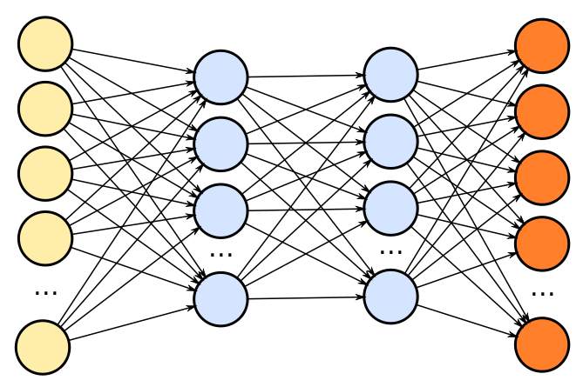
TensorFlow Mobile
Inference
Prediction
57.3% of the inference energy is spent on data movement
54.4% of the data movement energy comes from packing/unpacking and quantization

Slide 98
Packing
Matrix
Packing
Packed Matrix
Reorders elements of matrices to minimize cache misses during matrix multiplication
Up to 40% of the inference energy and 31% of inference execution time
Packing’s data movement accounts for up to 35.3% of the inference energy
A simple data reorganization process that requires simple arithmetic

Slide 99
Quantization
floating point
Quantization
integer
Converts 32-bit floating point to 8-bit integers to improve inference execution time and energy consumption
Up to 16.8% of the inference energy and 16.1% of inference execution time
Majority of quantization energy comes from data movement
A simple data conversion operation that requires shift, addition, and multiplication operations

Slide 100
Quantization
floating point
Quantization
integer
Converts 32-bit floating point to 8-bit integers to improve inference execution time and energy consumption
Based on our analysis, we conclude that:
Both functions are good candidates for PIM execution
It is feasible to implement them in PIM logic
Up to 16.8% of the inference energy and 16.1% of inference execution time
Majority of quantization energy comes from data movement
A simple data conversion operation that requires shift, addition, and multiplication operations

Slide 101
Evaluation Methodology
System Configuration (gem5 Simulator)
SoC: 4 OoO cores, 8-wide issue, 64 kB L1cache, 2MB L2 cache
PIM Core: 1 core per vault, 1-wide issue, 4-wide SIMD, 32kB L1 cache
3D-Stacked Memory: 2GB cube, 16 vaults per cube
Internal Bandwidth: 256GB/S
Off-Chip Channel Bandwidth: 32 GB/s
Baseline Memory: LPDDR3, 2GB, FR-FCFS scheduler
We study each target in isolation and emulate each separately and run them in our simulator
Notes:
and then analyzing the benefit of PIM in our simulator

Slide 102
Normalized Energy
TensorFlow Mobile
Video Playback and Capture
77.7% and 82.6% of energy reduction for texture tiling and packing comes from eliminating data movement
Chrome Browser
PIM core and PIM accelerator reduces energy consumption on average by 49.1% and 55.4%
Notes:
We make another obsrevation that using PIM accelerator provide limited energy reduction over PIM core, for some of these workloads, such as texture tiling. This is becase these kernels are data intensive and have low ocmputational compleity, and as a result, using fixed function accelerator does not provide significant energy reduction over the PIM core.

Slide 103
Normalized Runtime
Chrome Browser
Video Playback and Capture
TensorFlow Mobile
Offloading these kernels to PIM core and PIM accelerator improves performance on average by 44.6% and 54.2%
Notes:
PIM-Core and PIM-Acc significantly outperform CPU-Only across all kernels, improving performance by … This perfomance benefit come from higher bandwidth and lower access latency of 3D-stacked memory, because all of these kernels are data intensive.
Performance improvement of PIM-acc over PIM-core differes across different workloads. In some cases such as Texture Tiling, the performance improvement of PIM-Acc over PIM-Core is limited by the low computational complexity of these two kernels. But there are other cases, such as compression that benefit significantly from using PIM-Acc over PIM-Core in terms of performance, because these kernels are more compute-intensive and less data-intensive compared to texture tiling and.

Slide 104
Google Workloads for Consumer Devices: Mitigating Data Movement Bottlenecks
Amirali Boroumand
Saugata Ghose, Youngsok Kim, Rachata Ausavarungnirun,
Eric Shiu, Rahul Thakur, Daehyun Kim, Aki Kuusela, Allan Knies, Parthasarathy Ranganathan, Onur Mutlu
ASPLOS 2018
Notes:
Please drop by our talk during session 1 if you would like to learn more about data movement in Google workloads.

Slide 105
More on PIM for Mobile Devices
Amirali Boroumand, Saugata Ghose, Youngsok Kim, Rachata Ausavarungnirun, Eric Shiu, Rahul Thakur, Daehyun Kim, Aki Kuusela, Allan Knies, Parthasarathy Ranganathan, and Onur Mutlu, "Google Workloads for Consumer Devices: Mitigating Data Movement Bottlenecks" Proceedings of the 23rd International Conference on Architectural Support for Programming Languages and Operating Systems (ASPLOS), Williamsburg, VA, USA, March 2018.
62.7% of the total system energy
is spent on data movement

Slide 106
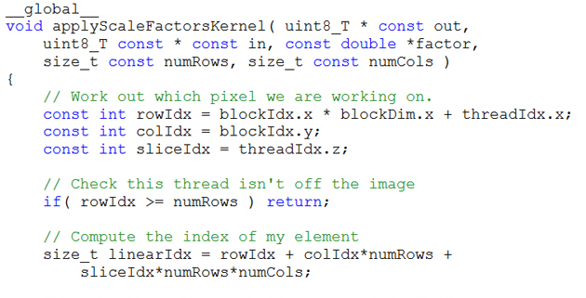
Truly Distributed GPU Processing with PIM?
3D-stacked memory
(memory stack)
SM (Streaming Multiprocessor)
Logic layer
Logic layer SM
Main GPU
Crossbar switch
Vault Ctrl
….
Vault Ctrl

Slide 107
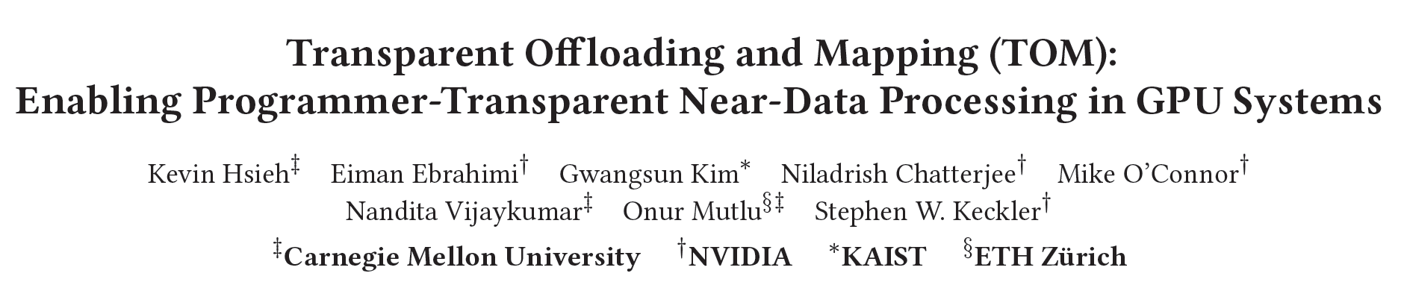
Accelerating GPU Execution with PIM (I)
Kevin Hsieh, Eiman Ebrahimi, Gwangsun Kim, Niladrish Chatterjee, Mike O'Connor, Nandita Vijaykumar, Onur Mutlu, and Stephen W. Keckler, "Transparent Offloading and Mapping (TOM): Enabling Programmer-Transparent Near-Data Processing in GPU Systems" Proceedings of the 43rd International Symposium on Computer Architecture (ISCA), Seoul, South Korea, June 2016. [Slides (pptx) (pdf)] [Lightning Session Slides (pptx) (pdf)]

Slide 108
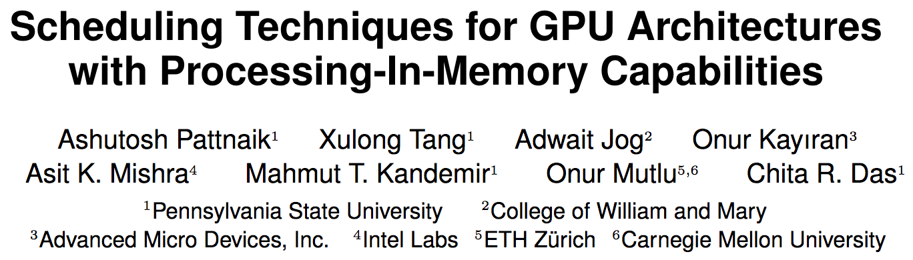
Accelerating GPU Execution with PIM (II)
Ashutosh Pattnaik, Xulong Tang, Adwait Jog, Onur Kayiran, Asit K. Mishra, Mahmut T. Kandemir, Onur Mutlu, and Chita R. Das, "Scheduling Techniques for GPU Architectures with Processing-In-Memory Capabilities" Proceedings of the 25th International Conference on Parallel Architectures and Compilation Techniques (PACT), Haifa, Israel, September 2016.

Slide 109
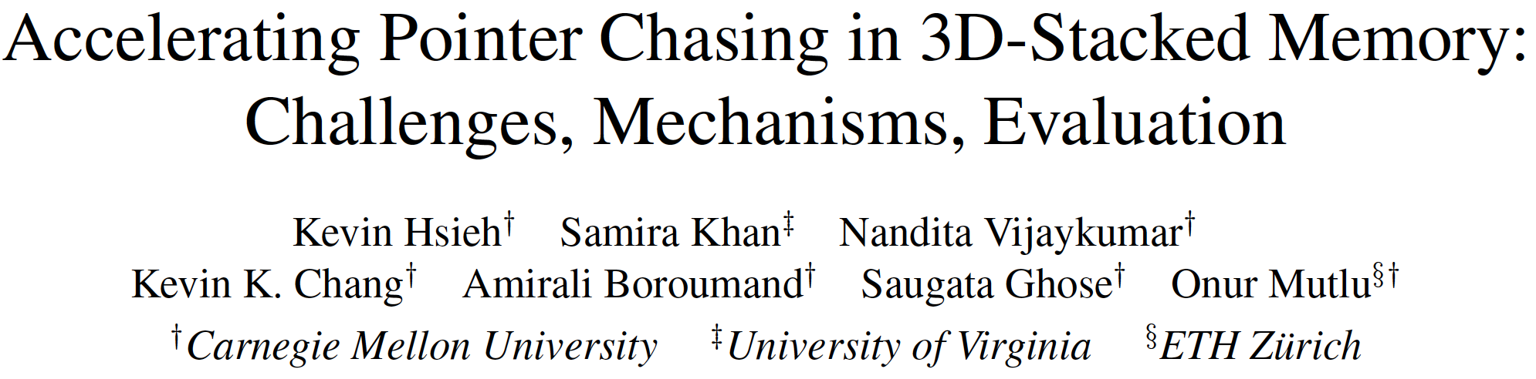
Accelerating Linked Data Structures
Kevin Hsieh, Samira Khan, Nandita Vijaykumar, Kevin K. Chang, Amirali Boroumand, Saugata Ghose, and Onur Mutlu, "Accelerating Pointer Chasing in 3D-Stacked Memory: Challenges, Mechanisms, Evaluation" Proceedings of the 34th IEEE International Conference on Computer Design (ICCD), Phoenix, AZ, USA, October 2016.

Slide 110
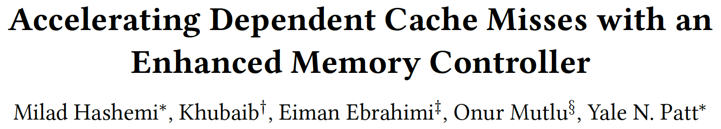
Accelerating Dependent Cache Misses
Milad Hashemi, Khubaib, Eiman Ebrahimi, Onur Mutlu, and Yale N. Patt, "Accelerating Dependent Cache Misses with an Enhanced Memory Controller" Proceedings of the 43rd International Symposium on Computer Architecture (ISCA), Seoul, South Korea, June 2016. [Slides (pptx) (pdf)] [Lightning Session Slides (pptx) (pdf)]

Slide 111
Two Key Questions in 3D-Stacked PIM
How can we accelerate important applications if we use 3D-stacked memory as a coarse-grained accelerator?
what is the architecture and programming model?
what are the mechanisms for acceleration?
What is the minimal processing-in-memory support we can provide?
without changing the system significantly
while achieving significant benefits

Slide 112
PEI: PIM-Enabled Instructions (Ideas)
Goal: Develop mechanisms to get the most out of near-data processing with minimal cost, minimal changes to the system, no changes to the programming model
Key Idea 1: Expose each PIM operation as a cache-coherent, virtually-addressed host processor instruction (called PEI) that operates on only a single cache block
e.g., __pim_add(&w.next_rank, value) → pim.add r1, (r2)
No changes sequential execution/programming model
No changes to virtual memory
Minimal changes to cache coherence
No need for data mapping: Each PEI restricted to a single memory module
Key Idea 2: Dynamically decide where to execute a PEI (i.e., the host processor or PIM accelerator) based on simple locality characteristics and simple hardware predictors
Execute each operation at the location that provides the best performance

Slide 113
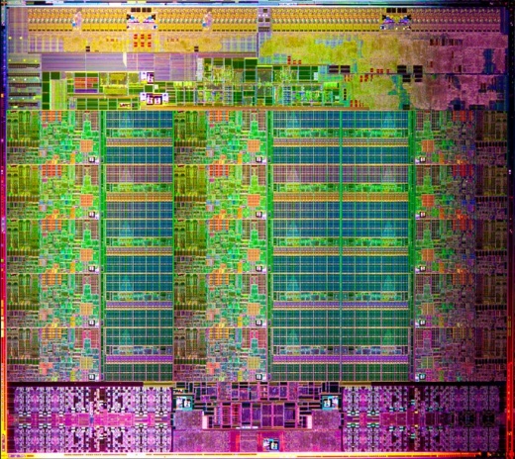
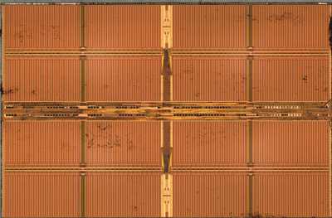
Simple PIM Operations as ISA Extensions (II)
for (v: graph.vertices) {
value = weight * v.rank;
for (w: v.successors) {
w.next_rank += value;
}
}
Host Processor
Main Memory
w.next_rank
w.next_rank
w.next_rank
w.next_rank
64 bytes in
64 bytes out
Conventional Architecture

Slide 114
Simple PIM Operations as ISA Extensions (III)
for (v: graph.vertices) {
value = weight * v.rank;
for (w: v.successors) {
__pim_add(&w.next_rank, value);
}
}
pim.add r1, (r2)
Host Processor
Main Memory
value
w.next_rank
w.next_rank
8 bytes in
0 bytes out
In-Memory Addition

Slide 115
Always Executing in Memory? Not A Good Idea
Increased
Memory Bandwidth Consumption
Caching very effective
Reduced Memory Bandwidth
Consumption due to
In-Memory Computation
More Vertices

Slide 116
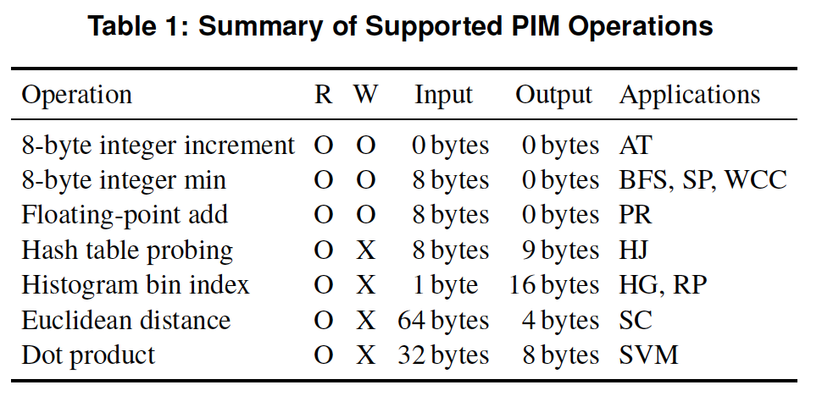
PEI: PIM-Enabled Instructions (Example)
for (v: graph.vertices) {
value = weight * v.rank;
for (w: v.successors) {
__pim_add(&w.next_rank, value);
}
}
pfence();
pim.add r1, (r2)
pfence
Executed either in memory or in the processor: dynamic decision
Low-cost locality monitoring for a single instruction
Cache-coherent, virtually-addressed, single cache block only
Atomic between different PEIs
Not atomic with normal instructions (use pfence for ordering)

Slide 117
PIM-Enabled Instructions
Key to practicality: single-cache-block restriction
Each PEI can access at most one last-level cache block
Similar restrictions exist in atomic instructions
Benefits
Localization: each PEI is bounded to one memory module
Interoperability: easier support for cache coherence and virtual memory
Simplified locality monitoring: data locality of PEIs can be identified simply by the cache control logic

Slide 118
Example (Abstract) PEI uArchitecture
Host Processor
3D-stacked Memory
Out-Of-Order Core
Last-Level Cache
DRAM Controller
L1 Cache
PCU
L2 Cache
PCU (PEI Computation Unit)
DRAM Controller
PCU
Network
HMC Controller
PMU (PEI
Mgmt Unit)
…
PIM Directory
Locality Monitor
DRAM Controller
PCU
Example PEI uArchitecture

Slide 119
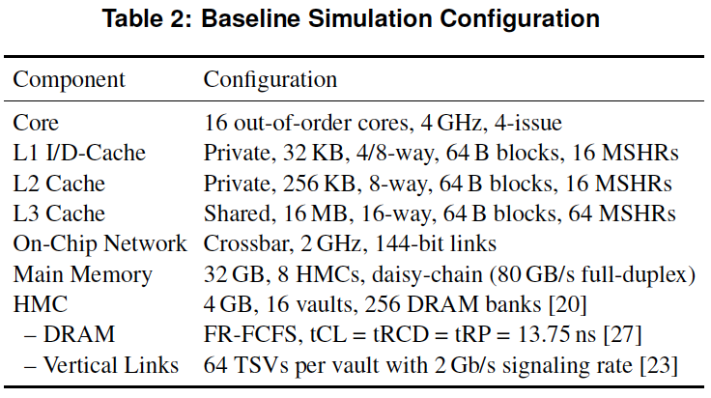
PEI: Initial Evaluation Results
Initial evaluations with 10 emerging data-intensive workloads
Large-scale graph processing
In-memory data analytics
Machine learning and data mining
Three input sets (small, medium, large) for each workload to analyze the impact of data locality
Pin-based cycle-level x86-64 simulation
Performance Improvement and Energy Reduction:
47% average speedup with large input data sets
32% speedup with small input data sets
25% avg. energy reduction in a single node with large input data sets

Slide 120
Evaluated Data-Intensive Applications
Ten emerging data-intensive workloads
Large-scale graph processing
Average teenage follower, BFS, PageRank, single-source shortest path, weakly connected components
In-memory data analytics
Hash join, histogram, radix partitioning
Machine learning and data mining
Streamcluster, SVM-RFE
Three input sets (small, medium, large) for each workload to show the impact of data locality

Slide 121
PEI Performance Delta: Large Data Sets
(Large Inputs, Baseline: Host-Only)

Slide 122
PEI Performance: Large Data Sets
(Large Inputs, Baseline: Host-Only)

Slide 123
PEI Performance Delta: Small Data Sets
(Small Inputs, Baseline: Host-Only)

Slide 124
PEI Performance: Small Data Sets
(Small Inputs, Baseline: Host-Only)

Slide 125
PEI Performance Delta: Medium Data Sets
(Medium Inputs, Baseline: Host-Only)

Slide 126
PEI Energy Consumption
Host-Only
PIM-Only
Locality-Aware

Slide 127
PEI: Advantages & Disadvantages
Advantages
+ Simple and low cost approach to PIM
+ No changes to programming model, virtual memory
+ Dynamically decides where to execute an instruction
Disadvantages
- Does not take full advantage of PIM potential
- Single cache block restriction is limiting

Slide 128

Simpler PIM: PIM-Enabled Instructions
Junwhan Ahn, Sungjoo Yoo, Onur Mutlu, and Kiyoung Choi, "PIM-Enabled Instructions: A Low-Overhead, Locality-Aware Processing-in-Memory Architecture" Proceedings of the 42nd International Symposium on Computer Architecture (ISCA), Portland, OR, June 2015. [Slides (pdf)] [Lightning Session Slides (pdf)]

Slide 129
Automatic Code and Data Mapping
Kevin Hsieh, Eiman Ebrahimi, Gwangsun Kim, Niladrish Chatterjee, Mike O'Connor, Nandita Vijaykumar, Onur Mutlu, and Stephen W. Keckler, "Transparent Offloading and Mapping (TOM): Enabling Programmer-Transparent Near-Data Processing in GPU Systems" Proceedings of the 43rd International Symposium on Computer Architecture (ISCA), Seoul, South Korea, June 2016. [Slides (pptx) (pdf)] [Lightning Session Slides (pptx) (pdf)]

Slide 130
Automatic Offloading of Critical Code
Milad Hashemi, Khubaib, Eiman Ebrahimi, Onur Mutlu, and Yale N. Patt, "Accelerating Dependent Cache Misses with an Enhanced Memory Controller" Proceedings of the 43rd International Symposium on Computer Architecture (ISCA), Seoul, South Korea, June 2016. [Slides (pptx) (pdf)] [Lightning Session Slides (pptx) (pdf)]

Slide 131
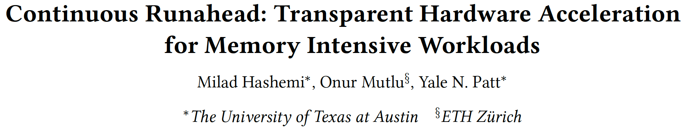
Automatic Offloading of Prefetch Mechanisms
Milad Hashemi, Onur Mutlu, and Yale N. Patt, "Continuous Runahead: Transparent Hardware Acceleration for Memory Intensive Workloads" Proceedings of the 49th International Symposium on Microarchitecture (MICRO), Taipei, Taiwan, October 2016. [Slides (pptx) (pdf)] [Lightning Session Slides (pdf)] [Poster (pptx) (pdf)]

Slide 132

Efficient Automatic Data Coherence Support
Amirali Boroumand, Saugata Ghose, Minesh Patel, Hasan Hassan, Brandon Lucia, Kevin Hsieh, Krishna T. Malladi, Hongzhong Zheng, and Onur Mutlu, "LazyPIM: An Efficient Cache Coherence Mechanism for Processing-in-Memory" IEEE Computer Architecture Letters (CAL), June 2016.

Slide 133
Challenge and Opportunity for Future
Fundamentally
Energy-Efficient
(Data-Centric)
Computing Architectures

Slide 134
Challenge and Opportunity for Future
Fundamentally
Low-Latency
(Data-Centric)
Computing Architectures

Slide 135
Challenge and Opportunity for Future
Computing Architectures
with
Minimal Data Movement

Slide 136
Agenda
Major Trends Affecting Main Memory
The Need for Intelligent Memory Controllers
Bottom Up: Push from Circuits and Devices
Top Down: Pull from Systems and Applications
Processing in Memory: Two Directions
Minimally Changing Memory Chips
Exploiting 3D-Stacked Memory
How to Enable Adoption of Processing in Memory
Conclusion

Slide 137
Eliminating the Adoption Barriers
How to Enable Adoption of Processing in Memory

Slide 138
Barriers to Adoption of PIM
1. Functionality of and applications for PIM
2. Ease of programming (interfaces and compiler/HW support)
3. System support: coherence & virtual memory
4. Runtime systems for adaptive scheduling, data mapping, access/sharing control
5. Infrastructures to assess benefits and feasibility

Slide 139
We Need to Revisit the Entire Stack
Problem
Algorithm
Program/Language
System Software
SW/HW Interface
Micro-architecture
Logic
Devices
Electrons

Slide 140
Key Challenge 1: Code Mapping
Challenge 1: Which operations should be executed in memory vs. in CPU?
?
3D-stacked memory
(memory stack)
SM (Streaming Multiprocessor)
?
Logic layer
Logic layer SM
Main GPU
Crossbar switch
Vault Ctrl
….
Vault Ctrl

Slide 141
Key Challenge 2: Data Mapping
Challenge 2: How should data be mapped to different 3D memory stacks?
3D-stacked memory
(memory stack)
SM (Streaming Multiprocessor)
Logic layer
Logic layer SM
Main GPU
Crossbar switch
Vault Ctrl
….
Vault Ctrl

Slide 142
How to Do the Code and Data Mapping?
Kevin Hsieh, Eiman Ebrahimi, Gwangsun Kim, Niladrish Chatterjee, Mike O'Connor, Nandita Vijaykumar, Onur Mutlu, and Stephen W. Keckler, "Transparent Offloading and Mapping (TOM): Enabling Programmer-Transparent Near-Data Processing in GPU Systems" Proceedings of the 43rd International Symposium on Computer Architecture (ISCA), Seoul, South Korea, June 2016. [Slides (pptx) (pdf)] [Lightning Session Slides (pptx) (pdf)]

Slide 143
How to Schedule Code?
Ashutosh Pattnaik, Xulong Tang, Adwait Jog, Onur Kayiran, Asit K. Mishra, Mahmut T. Kandemir, Onur Mutlu, and Chita R. Das, "Scheduling Techniques for GPU Architectures with Processing-In-Memory Capabilities" Proceedings of the 25th International Conference on Parallel Architectures and Compilation Techniques (PACT), Haifa, Israel, September 2016.

Slide 144
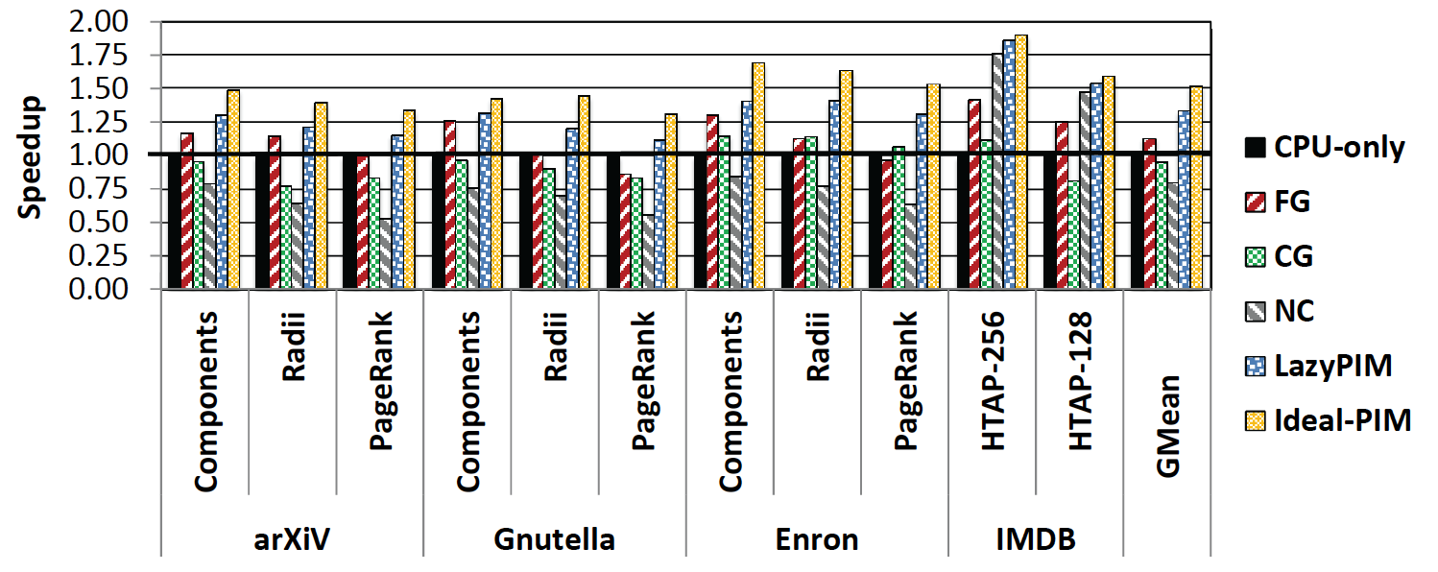
Challenge: Coherence for Hybrid CPU-PIM Apps
Traditional
coherence
No coherence
overhead

Slide 145
How to Maintain Coherence?
Amirali Boroumand, Saugata Ghose, Minesh Patel, Hasan Hassan, Brandon Lucia, Kevin Hsieh, Krishna T. Malladi, Hongzhong Zheng, and Onur Mutlu, "LazyPIM: An Efficient Cache Coherence Mechanism for Processing-in-Memory" IEEE Computer Architecture Letters (CAL), June 2016.

Slide 146
How to Support Virtual Memory?
Kevin Hsieh, Samira Khan, Nandita Vijaykumar, Kevin K. Chang, Amirali Boroumand, Saugata Ghose, and Onur Mutlu, "Accelerating Pointer Chasing in 3D-Stacked Memory: Challenges, Mechanisms, Evaluation" Proceedings of the 34th IEEE International Conference on Computer Design (ICCD), Phoenix, AZ, USA, October 2016.

Slide 147
How to Design Data Structures for PIM?
Zhiyu Liu, Irina Calciu, Maurice Herlihy, and Onur Mutlu, "Concurrent Data Structures for Near-Memory Computing" Proceedings of the 29th ACM Symposium on Parallelism in Algorithms and Architectures (SPAA), Washington, DC, USA, July 2017. [Slides (pptx) (pdf)]

Slide 148
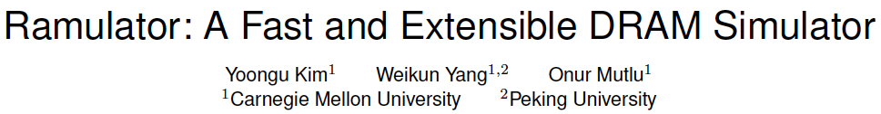
Simulation Infrastructures for PIM
Ramulator extended for PIM
Flexible and extensible DRAM simulator
Can model many different memory standards and proposals
Kim+, “Ramulator: A Flexible and Extensible DRAM Simulator”, IEEE CAL 2015.
https://github.com/CMU-SAFARI/ramulator

Slide 149
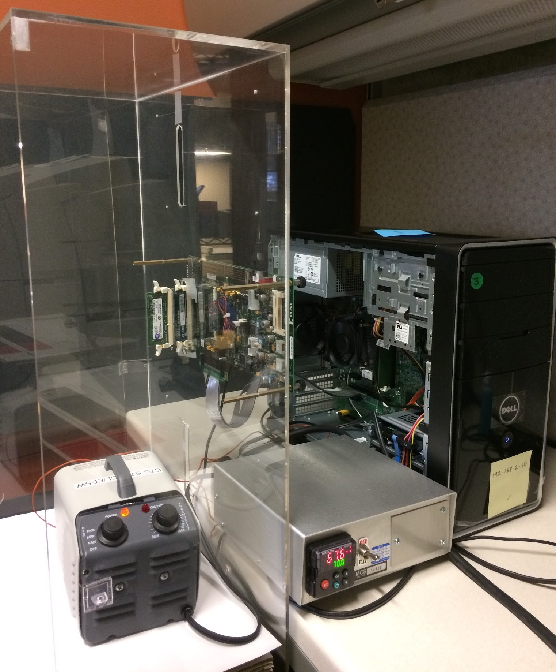
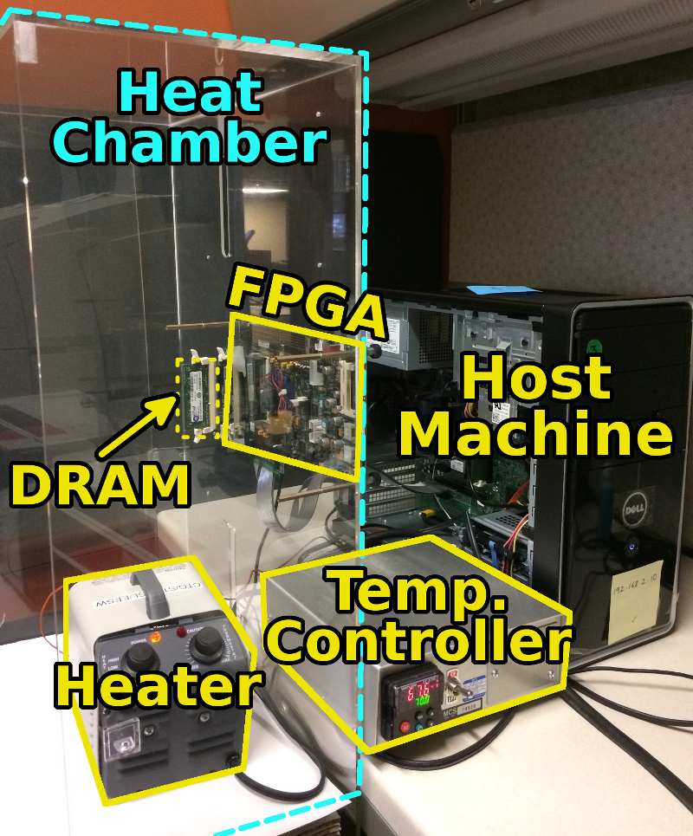
An FPGA-based Test-bed for PIM?
Hasan Hassan et al., SoftMC: A Flexible and Practical Open-Source Infrastructure for Enabling Experimental DRAM Studies HPCA 2017.
Flexible
Easy to Use (C++ API)
Open-source
github.com/CMU-SAFARI/SoftMC

Slide 150
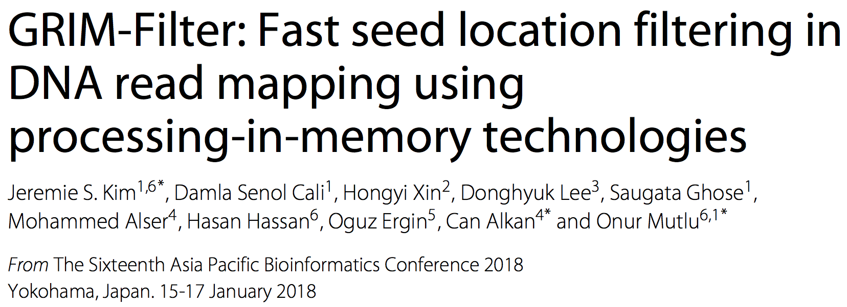
New Applications and Use Cases for PIM
Jeremie S. Kim, Damla Senol Cali, Hongyi Xin, Donghyuk Lee, Saugata Ghose, Mohammed Alser, Hasan Hassan, Oguz Ergin, Can Alkan, and Onur Mutlu, "GRIM-Filter: Fast Seed Location Filtering in DNA Read Mapping Using Processing-in-Memory Technologies" BMC Genomics, 2018. Proceedings of the 16th Asia Pacific Bioinformatics Conference (APBC), Yokohama, Japan, January 2018. arxiv.org Version (pdf)

Slide 151
Google Workloads for Consumer Devices: Mitigating Data Movement Bottlenecks
Amirali Boroumand
Saugata Ghose, Youngsok Kim, Rachata Ausavarungnirun,
Eric Shiu, Rahul Thakur, Daehyun Kim, Aki Kuusela, Allan Knies, Parthasarathy Ranganathan, Onur Mutlu

Slide 152

Genome Read In-Memory (GRIM) Filter: Fast Seed Location Filtering in DNA Read Mapping using Processing-in-Memory Technologies
Jeremie Kim,
Damla Senol, Hongyi Xin, Donghyuk Lee,
Saugata Ghose, Mohammed Alser, Hasan Hassan,
Oguz Ergin, Can Alkan, and Onur Mutlu
Notes:
Hello, my name is Jeremie Kim and I will be presenting Genome Read In-Memory Filter which will also be referred to as GRIM-Filter for short.
[CLICK]

Slide 153
Executive Summary
Genome Read Mapping is a very important problem and is the first step in many types of genomic analysis
Could lead to improved health care, medicine, quality of life
Read mapping is an approximate string matching problem
Find the best fit of 100 character strings into a 3 billion character dictionary
Alignment is currently the best method for determining the similarity between two strings, but is very expensive
We propose an in-memory processing algorithm GRIM-Filter for accelerating read mapping, by reducing the number of required alignments
We implement GRIM-Filter using in-memory processing within 3D-stacked memory and show up to 3.7x speedup.

Slide 154
GRIM-Filter in 3D-stacked DRAM
The layout of bit vectors in a bank enables filtering many bins in parallel
Customized logic for accumulation and comparison per genome segment
Low area overhead, simple implementation
Notes:
[CLICK]
Each DRAM layer is organized as an array of Banks
[CLICK]
and a bank is an array of cells with a row buffer. The row buffer holds one row at a time and uses this structure to transfer data with high bandwidth into the logic layer via TSVs
[CLICK]
We now show the distribution of bit vectors across the DRAM arrays to enable parallel processing of many bins.
[CLICK]
Each row represents a token's occurrence across many sequential bins. and the row of the appropriate token gets queried to find a vector showing the occurrence of the token across many bins.
These are the vectors are brought down into the logic layer to be operated on.
[CLICK]
[END-CLICK]

Slide 155
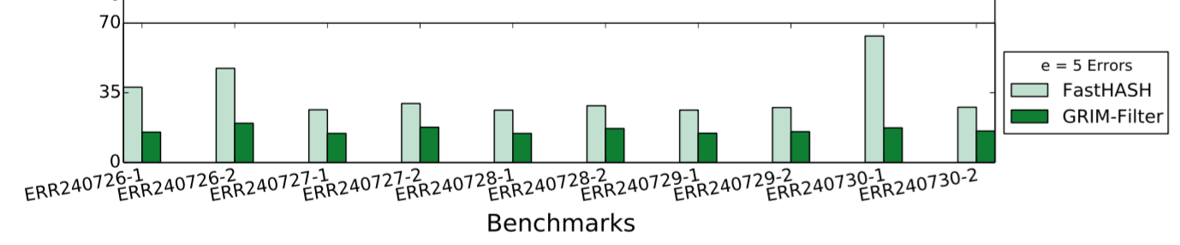
GRIM-Filter Performance
Time (x1000 seconds)
Benchmarks and their Execution Times
1.8x-3.7x performance benefit across real data sets
Notes:
We ran 10 separate experiments with real read data sets, consisting of approximately 4 million reads each, and got the following results. Compared to the previous best filter, our filter enjoys a 2x average end-to-end read mapper performance gain across the data sets, and a 6x average lower false positive rate. Again, these are the locations that were not discarded by the filter, but were then later discarded after alignment

Slide 156
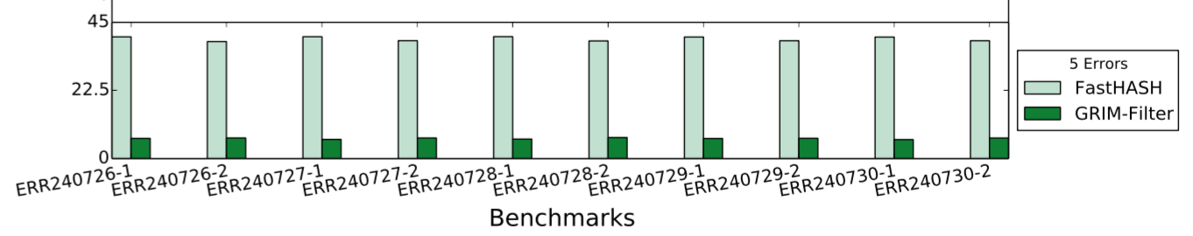
GRIM-Filter False Positive Rate
False Positive Rate (%)
Benchmarks and their False Positive Rates
5.6x-6.4x False Positive reduction across real data sets
Notes:
We ran 10 separate experiments with real read data sets, consisting of approximately 4 million reads each, and got the following results. Compared to the previous best filter, our filter enjoys a 2x average end-to-end read mapper performance gain across the data sets, and a 6x average lower false positive rate. Again, these are the locations that were not discarded by the filter, but were then later discarded after alignment

Slide 157
Conclusions
We propose an in memory filter algorithm to accelerate end-to-end genome read mapping by reducing the number of required alignments
Compared to the previous best filter
We observed 1.8x-3.7x speedup
We observed 5.6x-6.4x fewer false positives
GRIM-Filter is a universal filter that can be applied to any genome read mapper
Notes:
[CLICK]
We propose an in-memory filter to accelerate read mapping
[CLICK]
Compared to the previous best filter we show up to 3.7x end-to-end speedup on the same mapper and
We also observe on average 6x fewer false positives
[CLICK]
GRIM-Filter is a universal filter that can be applied to any read mapper and we hope these results encourage people to use processing in memory to improve other data intensive algorithms
[END-CLICK]

Slide 158
In-Memory DNA Sequence Analysis
Jeremie S. Kim, Damla Senol Cali, Hongyi Xin, Donghyuk Lee, Saugata Ghose, Mohammed Alser, Hasan Hassan, Oguz Ergin, Can Alkan, and Onur Mutlu, "GRIM-Filter: Fast Seed Location Filtering in DNA Read Mapping Using Processing-in-Memory Technologies" BMC Genomics, 2018. Proceedings of the 16th Asia Pacific Bioinformatics Conference (APBC), Yokohama, Japan, January 2018. arxiv.org Version (pdf)

Slide 159
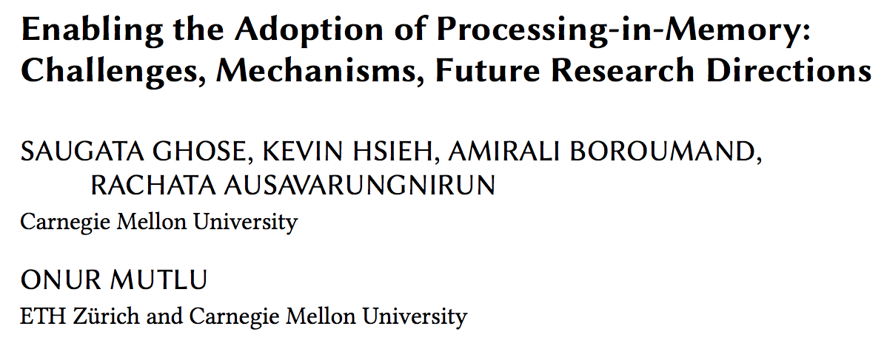
Open Problems: PIM Adoption
https://arxiv.org/pdf/1802.00320.pdf

Slide 160
Enabling the Paradigm Shift

Slide 161
Computer Architecture Today
You can revolutionize the way computers are built, if you understand both the hardware and the software (and change each accordingly)
You can invent new paradigms for computation, communication, and storage
Recommended book: Thomas Kuhn, “The Structure of Scientific Revolutions” (1962)
Pre-paradigm science: no clear consensus in the field
Normal science: dominant theory used to explain/improve things (business as usual); exceptions considered anomalies
Revolutionary science: underlying assumptions re-examined

Slide 162




Computer Architecture Today
You can revolutionize the way computers are built, if you understand both the hardware and the software (and change each accordingly)
You can invent new paradigms for computation, communication, and storage
Recommended book: Thomas Kuhn, “The Structure of Scientific Revolutions” (1962)
Pre-paradigm science: no clear consensus in the field
Normal science: dominant theory used to explain/improve things (business as usual); exceptions considered anomalies
Revolutionary science: underlying assumptions re-examined

Slide 163
Agenda
Major Trends Affecting Main Memory
The Need for Intelligent Memory Controllers
Bottom Up: Push from Circuits and Devices
Top Down: Pull from Systems and Applications
Processing in Memory: Two Directions
Minimally Changing Memory Chips
Exploiting 3D-Stacked Memory
How to Enable Adoption of Processing in Memory
Conclusion

Slide 164
Four Key Directions
Fundamentally Secure/Reliable/Safe Architectures
Fundamentally Energy-Efficient Architectures
Memory-centric (Data-centric) Architectures
Fundamentally Low-Latency Architectures
Architectures for Genomics, Medicine, Health

Slide 165
Maslow’s Hierarchy of Needs, A Third Time
Maslow, “A Theory of Human Motivation,”
Psychological Review, 1943.
Maslow, “Motivation and Personality,”
Book, 1954-1970.
Speed
Speed
Speed
Speed
Speed
Source: https://www.simplypsychology.org/maslow.html

Slide 166
Challenge and Opportunity for Future
Fundamentally
Energy-Efficient
(Data-Centric)
Computing Architectures

Slide 167
Challenge and Opportunity for Future
Fundamentally
Low-Latency
(Data-Centric)
Computing Architectures

Slide 168
Challenge and Opportunity for Future
Computing Architectures
with
Minimal Data Movement

Slide 169
PIM: Concluding Remarks

Slide 170
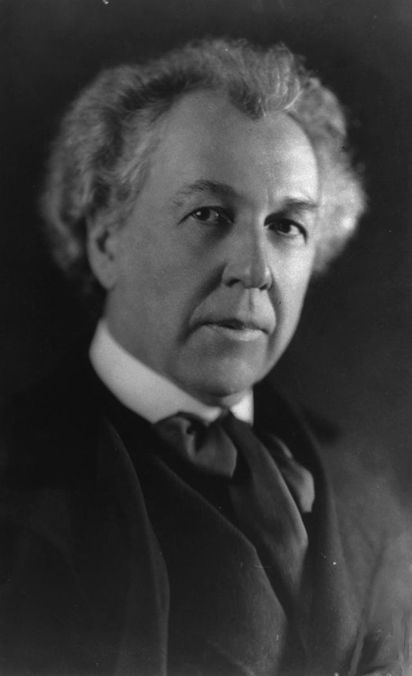
A Quote from A Famous Architect
“architecture […] based upon principle, and not upon precedent”

Slide 171
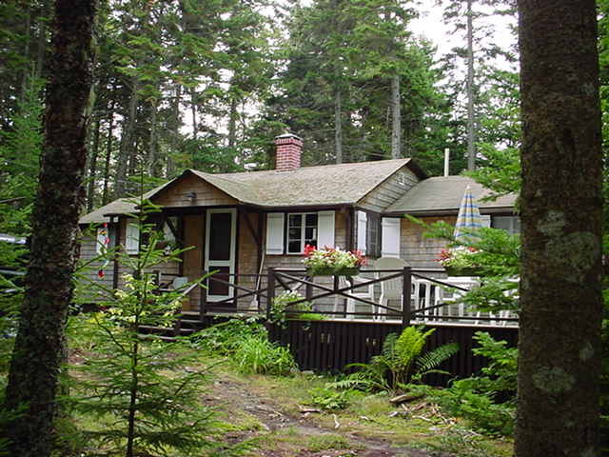
Precedent-Based Design?
“architecture […] based upon principle, and not upon precedent”

Slide 172

Principled Design
“architecture […] based upon principle, and not upon precedent”

Slide 173


Slide 174
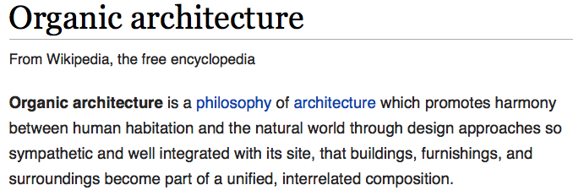
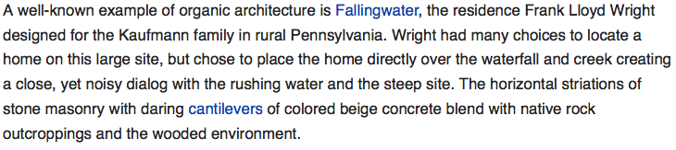
The Overarching Principle

Slide 175
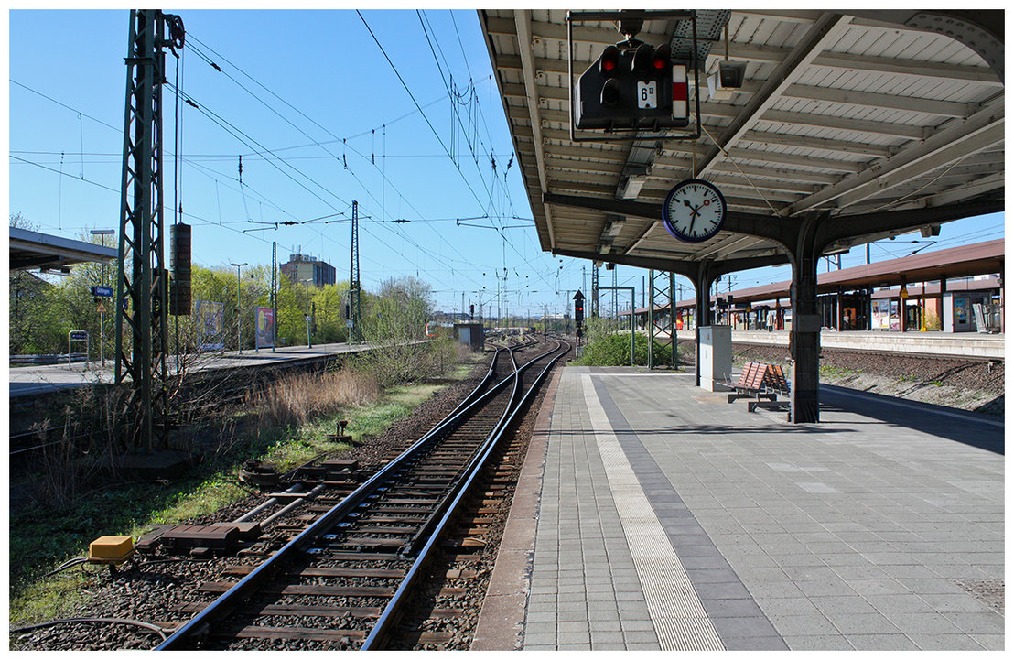
Another Example: Precedent-Based Design
Source: http://cookiemagik.deviantart.com/art/Train-station-207266944

Slide 176
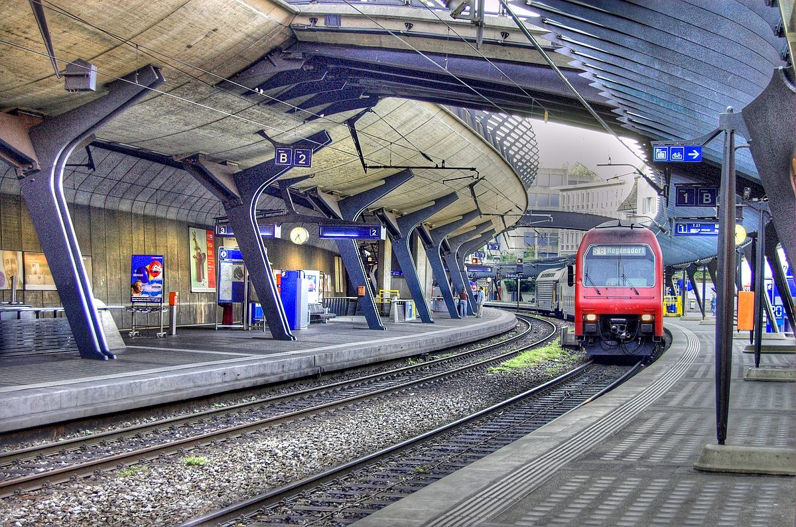
Principled Design
Source: By Toni_V, CC BY-SA 2.0, https://commons.wikimedia.org/w/index.php?curid=4087256

Slide 177
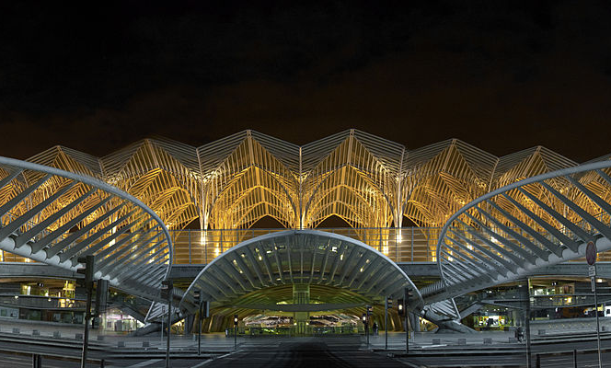
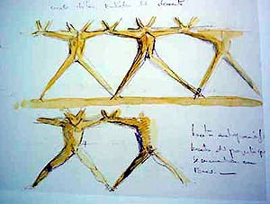
Another Principled Design
Source: By Martín Gómez Tagle - Lisbon, Portugal, CC BY-SA 3.0, https://commons.wikimedia.org/w/index.php?curid=13764903
Source: http://www.arcspace.com/exhibitions/unsorted/santiago-calatrava/

Slide 178
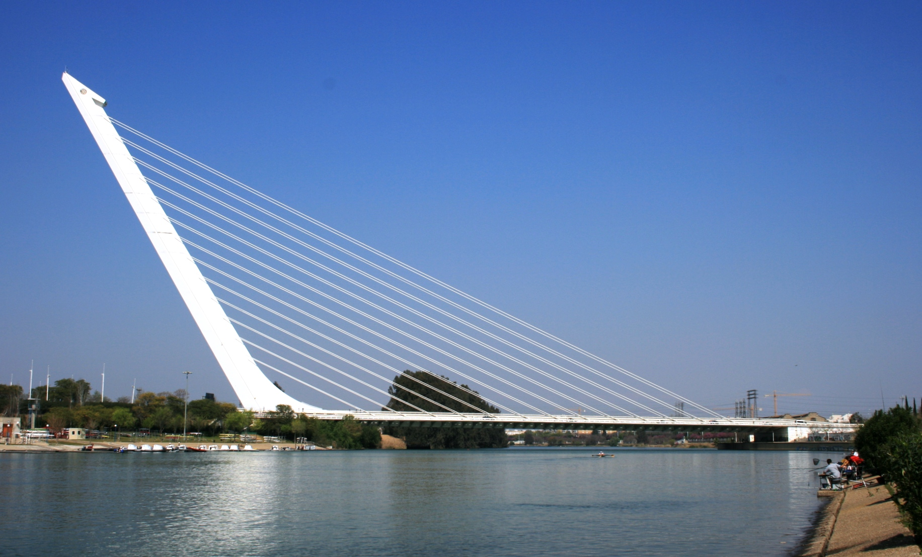
Another Principled Design
Source: De Galván - Puente del Alamillo.jpg on Enciclopedia.us.es, GFDL, https://commons.wikimedia.org/w/index.php?curid=15026095

Slide 179

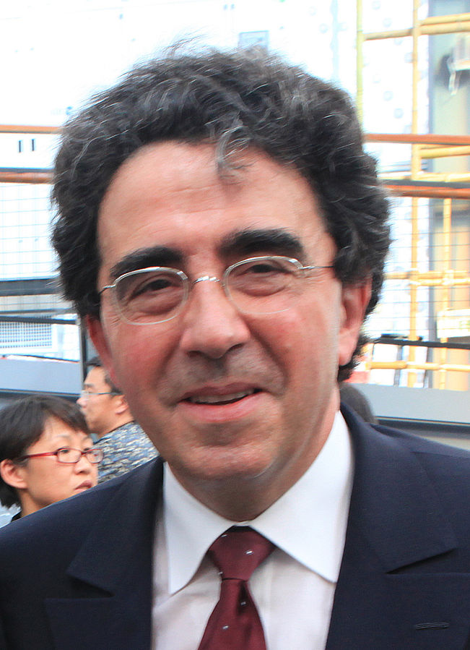
Principle Applied to Another Structure
Source: By 準建築人手札網站 Forgemind ArchiMedia - Flickr: IMG_2489.JPG, CC BY 2.0,
https://commons.wikimedia.org/w/index.php?curid=31493356, https://en.wikipedia.org/wiki/Santiago_Calatrava
Source: https://www.dezeen.com/2016/08/29/santiago-calatrava-oculus-world-trade-center-transportation-hub-new-york-photographs-hufton-crow/

Slide 180


The Overarching Principle

Slide 181

Overarching Principle for Computing?
Source: http://spectrum.ieee.org/image/MjYzMzAyMg.jpeg

Slide 182
Concluding Remarks
It is time to design principled system architectures to solve the memory problem
Design complete systems to be balanced, high-performance, and energy-efficient, i.e., data-centric (or memory-centric)
Enable computation capability inside and close to memory
This can
Lead to orders-of-magnitude improvements
Enable new applications & computing platforms
Enable better understanding of nature
…
Notes:
Perhaps we have taken processor-centric system design a bit too far

Slide 183
The Future of Processing in Memory is Bright
Regardless of challenges
in underlying technology and overlying problems/requirements
Problem
Can enable:
- Orders of magnitude
improvements
- New applications and
computing systems
Yet, we have to
- Think across the stack
- Design enabling systems
Algorithm
Program/Language
System Software
SW/HW Interface
Micro-architecture
Logic
Devices
Electrons

Slide 184
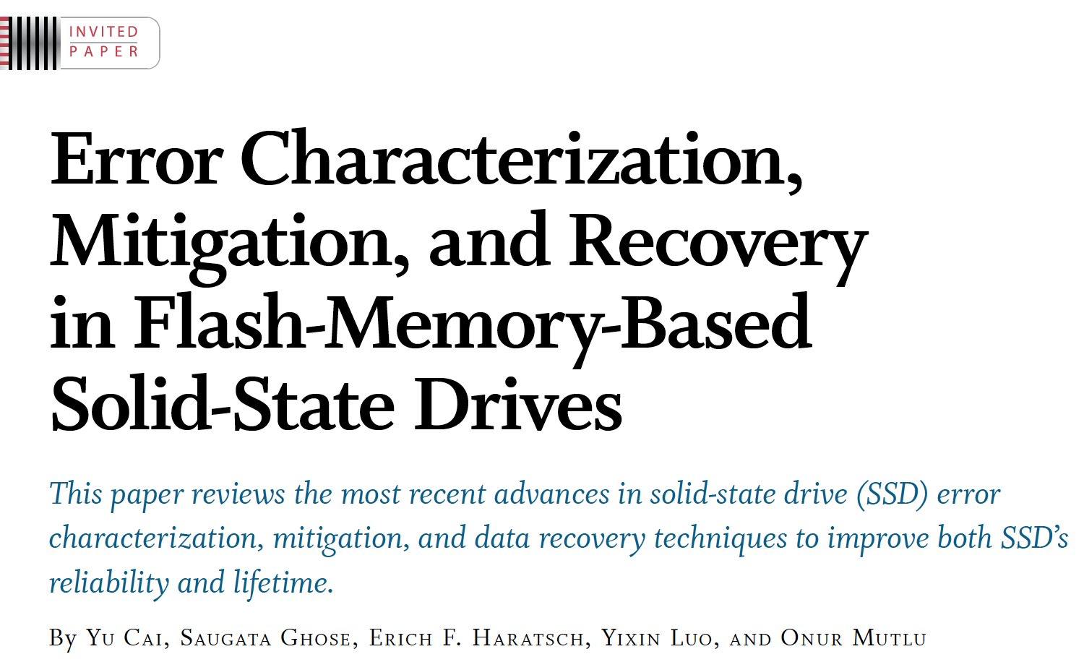
If In Doubt, See Other Doubtful Technologies
A very “doubtful” emerging technology
for at least two decades
Proceedings of the IEEE, Sept. 2017
https://arxiv.org/pdf/1706.08642

Slide 185
For Some Open Problems, See
https://arxiv.org/pdf/1802.00320.pdf

Slide 186
Memory Systems Fundamentals, Recent Research, Challenges, Opportunities Lecture 3: Processing-in-Memory
Prof. Onur Mutlu
omutlu@gmail.com
https://people.inf.ethz.ch/omutlu
8 October 2018
Technion Fast Course 2018

Slide 187
Backup Slides

Slide 188
Google Workloads for Consumer Devices: Mitigating Data Movement Bottlenecks
Amirali Boroumand
Saugata Ghose, Youngsok Kim, Rachata Ausavarungnirun,
Eric Shiu, Rahul Thakur, Daehyun Kim, Aki Kuusela, Allan Knies, Parthasarathy Ranganathan, Onur Mutlu

Slide 189
Consumer Devices
Consumer devices are everywhere!
Energy consumption is a first-class concern in consumer devices
Notes:
Consumer devices like tablets smartphone and wearable are now everywhere and used by billions of people.
One of the major challenge in these devices is battery limitation which makes the energy consumption a critical concern …

Slide 190
Popular Google Consumer Workloads
Chrome
TensorFlow Mobile
Google’s web browser
Google’s machine learning framework
Video Playback
Video Capture
Google’s video codec
Google’s video codec
Notes:
In this work, we take a look at widely-used google consumer workloads, to figure out the major sources of energy consumption.
We look at Google Chrome web brower. We take a look at Tensorflow, Google’s machine learning framework, and we also take a look at two important video related workloads, video playback and video capture, both rely on Google’s vp9 codec technology.

Slide 191
Energy Cost of Data Movement
1st key observation: 62.7% of the total system energy is spent on data movement
Data Movement
SoC
DRAM
CPU
L2
CPU
L1
CPU
CPU
Compute Unit
Processing-in-Memory (PIM)
Potential solution: move computation close to data
Challenge: limited area and energy budget
Notes:
Throughout our analysis, we make a key observation that out of all sources of energy consumption, data movement is a major contributor to the total system energy. We find that across all of the workloads, on average around 62.7% of total system energy is spent on data movement.
One way to reduce data movement cost is to move computation close to data, or …
One potential solution to address this cost it do move computation close to data, or in other words, do procesing in memory. However, the challenge is that these devices.
One potential solution to mitigate data movement cost and reduce total system energy is to execute data-movement heavy portions of application close to data, or in other words, do processing in memory. However, consumer devices are extermely limited in terms of area and power budget. So the question is can we move part of the data movement heavy portion given the limited area and energy budget. Our

Slide 192
Using PIM to Reduce Data Movement
2nd key observation: a significant fraction of data movement often comes from simple functions
We can design lightweight logic to implement these simple functions in memory
Small embedded low-power core
Small fixed-function accelerators
PIM Core
PIM Accelerator
PIM Accelerator
PIM Accelerator
Offloading to PIM logic reduces energy by 55.4% and improves performance by 54.2% on average
Notes:
To figure out if we can use processing in memory, we dig deeper into our analysis and we make another key observation that majority of data movement often comes form simple functions and pritmitives. We find that these simple function can be implemented in memory as either a small embedded core, or group of small fixed function accelerators. Our result shows that offloading these function to PIM logic can significantly reduce data movement for each function and reduce energy on average around 55% and improve perforamcne around 54%.

Slide 193
Goals
1
Understand the data movement related bottlenecks in modern consumer workloads
2
Analyze opportunities to mitigate data movement by using processing-in-memory (PIM)
3
Design PIM logic that can maximize energy efficiency given the limited area and energy budget in consumer devices

Slide 194
Outline
Introduction
Background
Analysis Methodology
Workload Analysis
Evaluation
Conclusion
Notes:
Before we jump into our analysis, lets talk about …

Slide 195

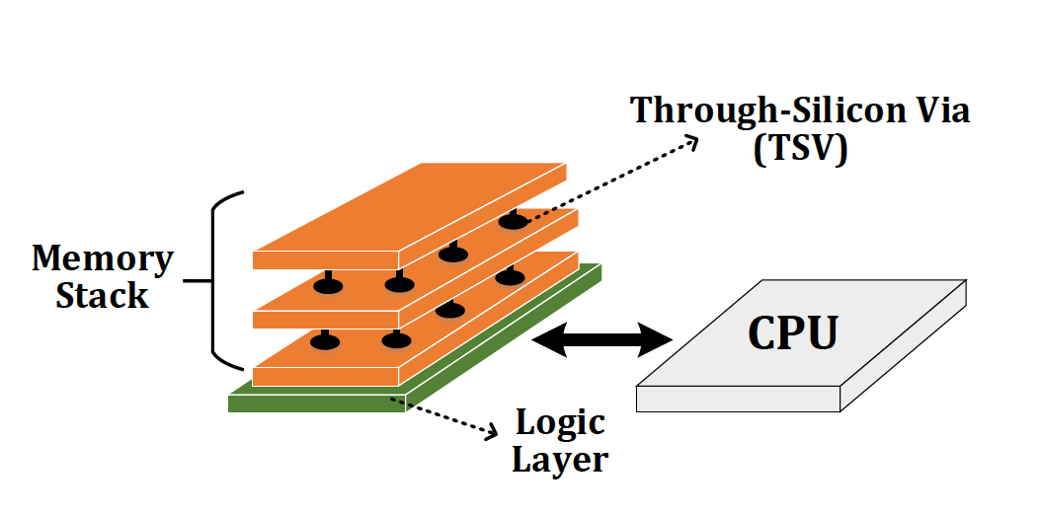
Potential Solution to Address Data Movement
Processing-in-Memory (PIM)
A potential solution to reduce data movement
Idea: move computation close to data
Enabled by recent advances in 3D-stacked memory
Reduces data movement
Exploits large in-memory bandwidth
Exploits shorter access latency to memory

Slide 196
Outline
Introduction
Background
Analysis Methodology
Workload Analysis
Evaluation
Conclusion

Slide 197
Workload Analysis Methodology
Workload Characterization
Chromebook with an Intel Celeron SoC and 2GB of DRAM
Extensively use performance counters within SoC
Energy Model
Sum of the energy consumption within the CPU, all caches, off-chip interconnects, and DRAM
DRAM
L2
L1
CPU
CPU
Notes:
Feedback: no wifi mention
We did our workload characterization on a Chromebook with an Intel SoC. We use performance counter within Soc to do our analysis.
We model energy as sum of the energy consumption that take place in CPU, caches, interconnet and DRAM. We turn off the wifi and use the lowest brightness for the display to ensure that the majority of the total energy is spent on the SoC and the memory system

Slide 198
PIM Logic Implementation
DRAM
Logic Layer
SoC
PIM Core
PIM Accelerator
PIM Accelerator
PIM Accelerator N
Customized embedded general-purpose core
Small fixed-function accelerators
No aggressive ILP techniques
Multiple copies of customized in-memory logic unit
256-bit SIMD unit
Notes:
During our analysis, for each workload, once we identify a PIM target, we consider two types of PIM logic implementation: (1) a general-purpose PIM core; and (2) a fixed-function PIM accelerator,
For the PIM core, we design a small general purpose core based on the charateristic of PIM candidate we find across the workloads. It’s simple embedded core that doesn’t have any aggressi ILP techniques, and it includes a SIMD unit to benefit from parallelism. For the PIM accelerator, we design a fixed function logic that has an in memory logic unit for each candidates we find. To benefit from paralalliesm, eacch PIM accelerator has multiple. ..
that can run any of the PIM candidates we find. Majortiy of the candidates we find are data instensive and performs simple operations, as a result, our PIM core doesn’t have any aggressive high performance/ILP techniques. It also has a SIMD unit as all of candidates we find benefit from parallelism.
For the PIM accelerator, for each of our PIM targets, we first design a customized in-memory logic unit, To benefit from parallelism, each PIM acceleartor has multiple copies of the in-memory logic unit,

Slide 199
Workload Analysis
Chrome
TensorFlow
Google’s web browser
Google’s machine learning framework
Video Playback
Video Capture
Google’s video codec
Google’s video Codec
Notes:
Now I’m gonna talk about our workload analysis. I will focus on chrome browser for the most of this talk.

Slide 200
Workload Analysis
Chrome
TensorFlow
Google’s web browser
Google’s machine learning framework
Video Playback
Video Capture
Google’s video codec
Google’s video codec

Slide 201

How Chrome Renders a Web Page
Loading and Parsing
Painting
HTML
HTML
HTML Parser
HTML Parser
Render Tree
Render Tree
Layout
Layout
Rasteriza-tion
Rasteriza-tion
Composit-ing
Composi-ting
CSS
CSS
CSS Parser
CSS Parser

Slide 202
How Chrome Renders a Web Page
Loading and Parsing
Layouting
Painting
assembles all layers into a final screen image
HTML
HTML
HTML Parser
HTML Parser
Render Tree
Render Tree
Layout
Layout
Rasteriza-tion
Rasteriza-tion
Composi-ting
Composi-ting
CSS
CSS
CSS Parser
CSS Parser
paints those objects and generates the bitmaps
calculates the visual elements and position of each object
Notes:
Feedback: the first major part just download the source files and parse them.
I just want to give you a brief high-level overview of how chrome renders a webpage. First the browser downloads the HTML and CSS, it starts parsing them to extract the content of the webpage. Then, based on those, at the next two stages, the browser calculate the visual rep and position of each object at the page. So at the end of layout stage, for each object, it knows the visual elements and the location of each object that needs to be drawn.. Then it goes to rasterization which is basically the process of painiting those object and generating the bitmaps. And at the final stages, compositing gets those bitmaps and composite them to gether and gerenate the final screen.
and calculate the visual represenation and postiion of each object in the page. At the end of the layout section,
Everything starts with downloading the HTML and CSS.
The chrome’s rendering engine, starts by parsing HTML files and store the the contents of a web page a tree of Node objects called the DOM tree. It also extracts style rules by parsing the CSS files. DOM tree and style rules together allows them to creates the render tree. The browser combines the DOM and style rules and generates "render tree,”. This tree is the visual representation of the document. The purpose of this tree is to enable painting the contents in their correct order. Up to this point we've calculated which nodes should be visible and their computed styles, but we have not calculated their exact position and size within the viewport of the device---that's the "layout" stage. Layout computes the exact position and size of each object.
Finally, now that we know which nodes are visible, and their computed styles and geometry, we can pass this information to the final stage, which converts each node in the render tree to actual pixels on the screen. This step is often referred to as "painting" or "rasterizing.” Painting is the process of filling in pixels into bitmaps. It involves drawing out text, colors, images, borders, and shadows, essentially every visual part of the elements. Finally, The rasterized bitmap (also known as a texture) is then sent to the GPU through a process called texture upload, after which the GPU performs compositing.
DOM: the contents of a web page are internally stored as a tree of Node objects called the DOM tree.
DOM: content of the webpage
Style rules: describe the style that need to be applies to the document
Render Tree: This tree is of visual elements in the order in which they will be displayed. It is the visual representation of the document. The purpose of this tree is to enable painting the contents in their correct order.
Layout: The calculation of geometric information (where and what size each element has) for every visible element. It’s normally done for the entire
Paint/rasterize: Painting is the process of filling in pixels. It involves drawing out text, colors, images, borders, and shadows, essentially every visual part of the elements. The drawing is typically done onto multiple surfaces, often called layers.
Compositing: Since the parts of the page were drawn into potentially multiple layers they need to be drawn to the screen in the correct order so that the page renders correctly. This is especially important for elements that overlap another, since a mistake could result in one element appearing over the top of another incorrectly.
https://aerotwist.com/blog/the-anatomy-of-a-frame/
The main subsystems are:
Input handling [technically not related to graphics per se, but nevertheless critical for many interactions]
Parsing, which turns a chunk of HTML into DOM nodes
Style, which resolves CSS onto the DOM
Layout, which figures out where DOM elements end up relative to one another
Paint setup, sometimes referred to as recording, which converts styled DOM elements into a display list (SkPicture) of drawing commands to paint later, on a per-layer basis
Painting, which converts the SkPicture of drawing commands into pixels in a bitmap somewhere (either in system memory or on the GPU if using Ganesh)
Compositing, which assembles all layers into a final screen image
and, less obviously, the presentation infrastructure responsible for actually pushing a new frame to the OS (i.e. the browser UI and its compositor, the GPU process which actually communicates with the GL driver, etc).

Slide 203
Browser Analysis
To satisfy user experience, the browser must provide:
Fast loading of webpages
Smooth scrolling of webpages
Quick switching between browser tabs
We focus on two important user interactions: 1) Page Scrolling 2) Tab Switching
Both include page loading
Notes:
So what are the important actions that users do with the browswe in the consumer devices?
The user perception of the browser speed is based on three factors: (1) page load time, (2) smooth web page scrolling, and (3) quick switching between browser tabs. In our study, we focus on two user interactions that impact these three factors, and govern a user’s browsing experience: (1) page scrolling and (2) tab switching. Note that each interaction includes page loading.
We emulate all these actions using Google’s temeletry freamework and focus on two actions:
Link it back to telemtery and probably remove the first bullet

Slide 204
Scrolling
Notes:
Now let me give you a little bit background on how prior works deal with the PIM coherence.

Slide 205
What Does Happen During Scrolling?
rasterization uses color blitters to convert the basic primitives into bitmaps
Rasterization generates the bitmap and sends it to GPU for compositing
Color Blitting
HTML
HTML Parser
Render Tree
Layout
Layout
Rasteriza-tion
Rasteriza-tion
Composi-itng
Composi-ting
CSS
CSS Parser
Texture Tiling
to minimize cache misses during compositing, the graphics driver reorganizes the bitmaps
Notes:
When user scrolls a webpage, it triggers three operations in the browser. It forces the browser to recompute the layout because the position of each object has changed, it forces the browser to do rasterization, because there are some new contents that needs to be rasterized, and the browser need to do compositing because there are new objects that need to be displayed.
In addition to that, I want to briefly talk about two other important functions that play a key role in our analysis. The first one is Texture Tiling, that happens between rasterization and compositing. To minimze cache misses, the graphic drivers invokes texture tiling to reo-rganize the bitmaps before sending them to GPU. Another important function is color blitting. Color blitting is inoked during the rasterization. And it is used to convert the basic primitives like text and line, into bitmaps.

Slide 206
Scrolling Energy Analysis
Google Docs
Gmail
Google Calendar
Word- Press
Twitter
Ani- mation
AVG
41.9% of page scrolling energy is spent on texture tiling and color blitting
Notes:
Here I’m showing the energy breakdown for scrolling on different web pages. This figures shows what functions in browser consume the most of the energy when user do the scrolling. Across all of the pages that we test, 41.9% of page scrolling energy is spent on two data-intensive components: (1) texture tiling, where the graphics driver reorganizes the linear bitmap data into a tiled format for the GPU; and (2) color blitting, which is invoked by the Skia library [51] during rasterization.
The rest of the energy is spent on a variety of other libraries and functions, each of which contributes to less than 1% of the total energy consumption
So now the question is, where exactly the energy is spent in the system?

Slide 207
Scrolling a Google Docs Web Page
77% of total energy consumption goes to data movement
A significant portion of total data movement comes from texture tiling and color blitting
37.7% of total system energy
Notes:
To answer that question, here I’m showing the energy break down, across different hardware components in the consumer devices. The x axis shows how much energy is spent on each components like DRAM, caches or CPU, and the y axis shows the total energy.
A major observation from this figure is that majority of energy is spent on accessing data from DRAM, or on-chip caches, or moving data over interconnects. Our anlaysis shows that 77% of total energy goes to data movement. Our analysis show that almost half of that data movement comes from texture tiling and color blitting. Here I’m showsing that for each of those functions how much of the energy goes to data movement and computation. We find that these two functions are extermely data intensive and the data movement generate by these
To answer this question, we dig deeper into our energy analysis. This figure shows gives more insight into where energy is spent in the system when we scroll through a Google Docs. We find that 77% of the total energy consumption is due to data movement. The data movement energy includes the energy consumed by DRAM, the off-chip interconnect, and the on-chip caches.
We then zoom into each of those function and we find out that these functions are both very data intensive and majority of their energy goes to dat amovment. In fact we find that the data movement generated by texture tiling and color blitting alone accounts for 37.7% of the total system energy
OR
In fact, the data movement generated by these two functions account for 37.7 of total system energy.
When you present the question, you would say: we first need to see whats going on during texture tiling.
To answer this question, we need to first figure what each function does. We start by texture tiling.

Slide 208
Scrolling a Google Docs Web Page
77% of total energy consumption goes to data movement
Can we use PIM to mitigate the data movement cost
for texture tiling and color blitting?
A significant portion of total data movement comes from texture tiling and color blitting
37.7% of total system energy
Notes:
To answer that question, here I’m showing the energy break down, across different hardware components in the consumer devices. The x axis shows how much energy is spent on each components like DRAM, caches or CPU, and the y axis shows the total energy.
A major observation from this figure is that majority of energy is spent on accessing data from DRAM, or on-chip caches, or moving data over interconnects. Our anlaysis shows that 77% of total energy goes to data movement. Our analysis show that almost half of that data movement comes from texture tiling and color blitting. Here I’m showsing that for each of those functions how much of the energy goes to data movement and computation. We find that these two functions are extermely data intensive and the data movement generate by these
To answer this question, we dig deeper into our energy analysis. This figure shows gives more insight into where energy is spent in the system when we scroll through a Google Docs. We find that 77% of the total energy consumption is due to data movement. The data movement energy includes the energy consumed by DRAM, the off-chip interconnect, and the on-chip caches.
We then zoom into each of those function and we find out that these functions are both very data intensive and majority of their energy goes to dat amovment. In fact we find that the data movement generated by texture tiling and color blitting alone accounts for 37.7% of the total system energy
OR
In fact, the data movement generated by these two functions account for 37.7 of total system energy.
When you present the question, you would say: we first need to see whats going on during texture tiling.
To answer this question, we need to first figure what each function does. We start by texture tiling.

Slide 209
Can We Use PIM for Texture Tiling?
CPU-Only
time
CPU + PIM
CPU
Memory
CPU
PIM
Rasterization
Rasterization
Linear
Linear
Bitmap
Read Bitmap
Bitmap
idle
Conversion
Texture Tiling
Conversion
Texture
high
Invoke
Tiles
data movement
Compositing
Write Back
Texture
Invoke
Tiles
Compositing
1) Eliminate a significant portion of data movement
Major sources of data movement: 1) poor data locality 2) large rasterized bitmap size (e.g. 4MB)
Texture tiling is a good candidate for PIM execution
2) Free up CPU to perform
Notes:
Feedback: move stuff from CPU-only to CPU+PIM, not fade
So can we use PIM for texture tiling? To answer that, here I’m showing you a bit more detailed of interactions between CPU and memory during texture tiling. As I said the cpu performs rasterization and store the bitmap in memory. It then needs to invoke Compositing process. Texture Tiling happens in between. The graphic driver read the bitmap, convert it to a more cache friendly format for GPU, and write it back to a location that GPU reads from.. It then invoke compositing. That’s where a lot of data movement happens because there is poor data locality during this processn and the bitmap sizes are so large that in some cases they don’t even fit into last level cache. This process is a good candidate for PIM. Here I’m showing what would happen if we move it to PIM. PIM logic access the bitmaps in memory, do the conversion, and write it to the location gpu access that. This way, it eliminates a significant porition of data movement and it also frees up the cpu to do other important task
So whats texture Tiglin. Here I want to walk you through the major steps during Texture tiling.
Texture tiling happens after rasterization and before compositing. Rasterization generates a rasterized bitmap. Then, that bitmap is sent to GPU for compositing. After rasterization, compositing accesses each texture in both the horizontal and vertical directions. To minimize cache misses during compositing, the graphics driver reads the rasterized bitmap ( 2 ) and converts the bitmap into a tiled texture layout
Because of this high amount of data movement, texture tiling is a good candidate for PIM execution. By moving texture tiling to PIM, we can let the PIM logic read the bitmap, performs the tiling operation in the memory, and the write it to a location that GPU will access. This wa,y we can elimnate a significant portion of data movement as it happens close to data and avoid moving the texture back and forth between memory and CPU . we can free up the CPU ( 5 ) to perform other important compute-intensive tasks in Chrome, such as handling user interaction, executing JavaScript code, or rasterizing other render objects.

Slide 210
Can We Implement Texture Tiling in PIM Logic?
Linear Bitmap
Texture Tiling
Tiled Texture
Requires simple primitives: memcopy, bitwise operations, and simple arithmetic operations
PIM Core
PIM Accelerator
9.4% of the area available for PIM logic
7.1% of the area available for PIM logic
PIM core and PIM accelerator are feasible to implement in-memory Texture Tiling
Notes:
The next question is whether texture tiling is feasible to be implemented using PIM in consumer devices. To answer that, we analyze the texutre tiling in detail and find that
hat texture tiling requires only simple primitives: memcopy, bitwise operations, and simple arithmetic operations (e.g., addition).
These operations can be performed at high performance on our PIM core, and they can easily be implemented as a fixed function PIM accelerator.
Our analysis hsows that each of them takes less than 10% of the area available per vault, and as a result, both are feasible to implement in a consumer device with 3D-stacked memory
As we explained before our PIM core is …
Our PIM accelerator for texture tiling consists of multiple in-memory tiling units.
Each in-memory tiling unit consists of only a simple ALU, and operates on a single 4 kB tile.
We empirically decide to use four in-memory tiling units in each PIM accelerator
We conclude that the area required for texture tiling PIM logic is small, making the PIM logic feasible to implement in a consumer device with 3D-stacked memory

Slide 211
Color Blitting Analysis
Generates a large amount of data movement
Accounts for 19.1% of the total system energy during scrolling
Color blitting is a good candidate
for PIM execution
Requires low-cost operations: Memset, simple arithmetic, and shift operations
It is feasible to implement color blitting in PIM core and PIM accelerator
Notes:
We did the same analysis for Color Blitting. Because of lack of time, I will talk about the key points here.
Majority come from its streaming access pattern and the large sizes of the bitmaps (e.g., 1024x1024 pixels).
The function itself require simple computations

Slide 212
Scrolling Wrap Up
Texture tiling and color blitting account for a significant portion (41.9%) of energy consumption
37.7% of total system energy goes to data movement generated by these functions
Both functions can benefit significantly from PIM execution
1
Both functions are feasible to implement as PIM logic
2
Notes:
So here I just want to wrap up our analysis for page scrolling. We found two data intensive functions that account for a significant portion of energy during scrolling. We find that both function can significantly benfti from PIM execution. We also find that both functions are simple enough that can be impelemented at pim logic

Slide 213
Tab Switching
Notes:
Now let me give you a little bit background on how prior works deal with the PIM coherence.

Slide 214


What Happens During Tab Switching?
Chrome employs a multi-process architecture
Each tab is a separate process
Main operations during tab switching:
Context switch
Load the new page
Chrome Process
…
Tab 1 Process
Tab 2 Process
Tab N Process
Notes:
Chrome uses a multi-process architecture, where each tab has its own application process for rendering the page displayed in the tab to improve reliability and performance.
When a user switches between browser tabs, this triggers two operations: (1) a context switch to the process for the selected tab, and (2) a load operation for the new page.

Slide 215
Memory Consumption
Primary concerns during tab switching:
How fast a new tab loads and becomes interactive
Memory consumption
Chrome uses compression to reduce each tab’s memory footprint
DRAM
CPU
Inactive Tab
Compressed Tab
ZRAM
Decompression
Compression
Notes:
There are two primary concerns during tab switching: (1) how fast a new tab loads and becomes interactive, as this directly affects user satisfaction; and (2) memory consumption.
Memory consumption is a major concern for three reasons. First, the average memory footprint of a web page has increased significantly in recent years because of increased use of images, JavaScript, and video in modern web pages. Second users tend to open multiple tabs at a time with each tab consuming additional memory. Third, consumer devices typically have a much lower memory capacity than server or desktop systems, and without careful memory management, Chrome could run out of memory on these systems over time.

Slide 216
Data Movement Study
To study data movement during tab switching, we emulate a user switching through 50 tabs
We make two key observations:
Compression and decompression contribute to18.1% of the total system energy
1
19.6 GB of data moves between CPU and ZRAM
2
Notes:
Moves between CPU and ZRAM
There are two primary concerns during tab switching: (1) how fast a new tab loads and becomes interactive, as this directly affects user satisfaction; and (2) memory consumption.
Memory consumption is a major concern for three reasons. First, the average memory footprint of a web page has increased significantly in recent years because of increased use of images, JavaScript, and video in modern web pages. Second users tend to open multiple tabs at a time with each tab consuming additional memory. Third, consumer devices typically have a much lower memory capacity than server or desktop systems, and without careful memory management, Chrome could run out of memory on these systems over time.

Slide 217
Can We Use PIM to Mitigate the Cost?
CPU-Only
time
CPU + PIM
CPU
Memory
CPU
PIM
Swap out N pages
Swap out N pages
Uncompressed
Uncompressed
Pages
Pages
Read N Pages
Other tasks
Compress
Compress
high
compression
No off-chip data movement
data movement
ZRAM
Write back
Other tasks
ZRAM
PIM core and PIM accelerator are feasible to implement in-memory compression/decompression
Notes:
Now we want to see if we can mitigate data movement cost with PIM. To answer that, lets again take a look at interaction between CPU and memory when CPU wants to swap out N pages. we need to figure out where the data movement happens. Here shows what happens when CPU wants to swap out N inactive pages. it first read the inactive page data, compress the data ( 2 ), and write the compressed data to ZRAM. This incur a lot of overhead. This operation is a good fit for PIM as (1) it cause a large amount of data movement; and (2) compression can be handled in the background, since none of the active tab processes need the data that is being compressed
Our analysis shows that the compression algorithm used by chrome is simple enough that both pim core and …
To wrap up, we found that a lot of data movement happens during tab switching as chrome tries to compress and decompress tabs. We find that both compression and decompression can significantly benefit from PIM execution and are feasible to be implemented at PIM logic
Now on the right what happens when we offload compression to PIM. In this case, the CPU only informs the PIM logic about the pages that need to be swapped out, and the PIM logic operates on the uncompressed page data that is already in memory. This (1) eliminates the off-chip page data movement that took place during CPU-based compression, and (2) frees up the CPU to perform other tasks while PIM performs compression in the background. We observe a similar behavior during decompression.

Slide 218
Tab Switching Wrap Up
A large amount of data movement happens during tab switching as Chrome attempts to compress and decompress tabs
Both functions can benefit from PIM execution and can be implemented as PIM logic
2
Notes:
To wrap up, we found that a lot of data movement happens during tab switching as chrome tries to compress and decompress tabs. We find that both compression and decompression can significantly benefit from PIM execution and are feasible to be implemented at PIM logic

Slide 219
Workload Analysis
Chrome
TensorFlow
Google’s web browser
Google’s machine learning framework
Video Playback
Video Capture
Google’s video codec
Google’s video codec

Slide 220
Workload Analysis
Chrome
TensorFlow
Google’s web browser
Google’s machine learning framework
Video Playback
Video Capture
Google’s video codec
Google’s video codec

Slide 221
TensorFlow Mobile
Inference
Prediction
57.3% of the inference energy is spent on data movement
54.4% of the data movement energy comes from packing/unpacking and quantization

Slide 222
Packing
Matrix
Packing
Packed Matrix
Reorders elements of matrices to minimize cache misses during matrix multiplication
Up to 40% of the inference energy and 31% of inference execution time
Packing’s data movement accounts for up to 35.3% of the inference energy
A simple data reorganization process that requires simple arithmetic

Slide 223
Quantization
floating point
Quantization
integer
Converts 32-bit floating point to 8-bit integers to improve inference execution time and energy consumption
Up to 16.8% of the inference energy and 16.1% of inference execution time
Majority of quantization energy comes from data movement
A simple data conversion operation that requires shift, addition, and multiplication operations

Slide 224
Quantization
floating point
Quantization
integer
Converts 32-bit floating point to 8-bit integers to improve inference execution time and energy consumption
Based on our analysis, we conclude that:
Both functions are good candidates for PIM execution
It is feasible to implement them in PIM logic
Up to 16.8% of the inference energy and 16.1% of inference execution time
Majority of quantization energy comes from data movement
A simple data conversion operation that requires shift, addition, and multiplication operations

Slide 225

Video Playback and Capture
Compressed video
Captured video
Compressed video
Display
VP9 Decoder
VP9 Encoder
Majority of energy is spent on data movement
Majority of data movement comes from simple functions in decoding and encoding pipelines
Notes:
We also analyze video play back and video capture. We take a look at energy consumption when vp9 decider is yaed to playback a netflix film, and when vp9 wncoder is used to do real-time encoding of ...
We find that for both of these workloads data movemwnt is a major contributor to the total system enery.
When we dog deeper we find that they are simple functions in decoding and encoding pipeline that generate the majority of dara movement.
Please refer to the paper for more detail.

Slide 226
Outline
Introduction
Background
Analysis Methodology
Workload Analysis
Evaluation
Conclusion

Slide 227
Evaluation Methodology
System Configuration (gem5 Simulator)
SoC: 4 OoO cores, 8-wide issue, 64 kB L1cache, 2MB L2 cache
PIM Core: 1 core per vault, 1-wide issue, 4-wide SIMD, 32kB L1 cache
3D-Stacked Memory: 2GB cube, 16 vaults per cube
Internal Bandwidth: 256GB/S
Off-Chip Channel Bandwidth: 32 GB/s
Baseline Memory: LPDDR3, 2GB, FR-FCFS scheduler
We study each target in isolation and emulate each separately and run them in our simulator
Notes:
and then analyzing the benefit of PIM in our simulator

Slide 228
Normalized Energy
TensorFlow Mobile
Video Playback and Capture
77.7% and 82.6% of energy reduction for texture tiling and packing comes from eliminating data movement
Chrome Browser
PIM core and PIM accelerator reduces energy consumption on average by 49.1% and 55.4%
Notes:
We make another obsrevation that using PIM accelerator provide limited energy reduction over PIM core, for some of these workloads, such as texture tiling. This is becase these kernels are data intensive and have low ocmputational compleity, and as a result, using fixed function accelerator does not provide significant energy reduction over the PIM core.

Slide 229
Normalized Runtime
Chrome Browser
Video Playback and Capture
TensorFlow Mobile
Offloading these kernels to PIM core and PIM accelerator improves performance on average by 44.6% and 54.2%
Notes:
PIM-Core and PIM-Acc significantly outperform CPU-Only across all kernels, improving performance by … This perfomance benefit come from higher bandwidth and lower access latency of 3D-stacked memory, because all of these kernels are data intensive.
Performance improvement of PIM-acc over PIM-core differes across different workloads. In some cases such as Texture Tiling, the performance improvement of PIM-Acc over PIM-Core is limited by the low computational complexity of these two kernels. But there are other cases, such as compression that benefit significantly from using PIM-Acc over PIM-Core in terms of performance, because these kernels are more compute-intensive and less data-intensive compared to texture tiling and.

Slide 230
Conclusion
Energy consumption is a major challenge in consumer devices
We conduct an in-depth analysis of popular Google consumer workloads
62.7% of the total system energy is spent on data movement
Most of the data movement comes from simple functions that consist of simple operations
We use PIM to reduce data movement cost
We design lightweight logic to implement simple operations in DRAM
Reduces total energy by 55.4% on average
Reduces execution time by 54.2% on average
PIM Core
PIM Accelerator
PIM Accelerator
PIM Accelerator

Slide 231
Google Workloads for Consumer Devices: Mitigating Data Movement Bottlenecks
Amirali Boroumand
Saugata Ghose, Youngsok Kim, Rachata Ausavarungnirun,
Eric Shiu, Rahul Thakur, Daehyun Kim, Aki Kuusela, Allan Knies, Parthasarathy Ranganathan, Onur Mutlu

Slide 232
3D-Stacked PIM on Mobile Devices
Amirali Boroumand, Saugata Ghose, Youngsok Kim, Rachata Ausavarungnirun, Eric Shiu, Rahul Thakur, Daehyun Kim, Aki Kuusela, Allan Knies, Parthasarathy Ranganathan, and Onur Mutlu, "Google Workloads for Consumer Devices: Mitigating Data Movement Bottlenecks" Proceedings of the 23rd International Conference on Architectural Support for Programming Languages and Operating Systems (ASPLOS), Williamsburg, VA, USA, March 2018.

Slide 233


Accelerating Pointer Chasing in 3D-Stacked Memory: Challenges, Mechanisms, Evaluation
Kevin Hsieh
Samira Khan, Nandita Vijaykumar, Kevin K. Chang,
Amirali Boroumand, Saugata Ghose, Onur Mutlu

Slide 234
Executive Summary
Our Goal: Accelerating pointer chasing inside main memory
Challenges: Parallelism challenge and Address translation challenge
Our Solution: In-Memory PoInter Chasing Accelerator (IMPICA)
Address-access decoupling: enabling parallelism in the accelerator with low cost
IMPICA page table: low cost page table structure
Key Results:
1.2X – 1.9X speedup for pointer chasing operations, +16% database throughput
6% - 41% reduction in energy consumption

Slide 235




Linked Data Structures
Linked data structures are widely used in many important applications
Linked data structures are
connected by pointers
Database
Key-value stores
B-Tree
Hash Table

Slide 236

The Problem: Pointer Chasing
Traversing linked data structures requires chasing pointers
Find(A)
H
Addr (A)
Addr (E)
Addr (H)
E
Q
Data (H)
Data (E)
A
F
M
Data (A)
MEM
Serialized and irregular access pattern
6X cycles per instruction in real workloads

Slide 237
Our Goal
Accelerating pointer chasing inside main memory
Find(A)
H
Find
(A)
E
Q
Data (A)
DRAM layers
A
F
M
MEM
Logic layer

Slide 238
Outline
Motivation and Our Approach
Parallelism Challenge
IMPICA Core Architecture
Address Translation Challenge
IMPICA Page Table
Evaluation
Conclusion

Slide 239
Parallelism Challenge
Time
CPU core
Comp
Memory
access
Comp
CPU core
Comp
Memory
access
Comp
In-Memory Accelerator
Comp
Memory access
Comp
Comp
Memory access
Comp
Slower for two operations
Faster for one operation

Slide 240
Parallelism Challenge and Opportunity
A simple in-memory accelerator can still be slower than multiple CPU cores
Opportunity: a pointer-chasing accelerator spends a long time waiting for memory
CPU core
CPU core
CPU core
Accelerator
Comp
Memory access (10-15X of Comp)
Comp

Slide 241
Our Solution: Address-Access Decoupling
Time
CPU core
Comp
Memory
access
Comp
CPU core
Comp
Memory
access
Comp
Address-access decoupling enables parallelism in both engines with low cost
Address Engine
Comp
Comp
Comp
Comp
Memory access
Access Engine
Memory access

Slide 242
IMPICA Core Architecture
DRAM
DRAM Dies
DRAM Layers
Logic Layer
Memory Controller
IMPICA Cache
Access Queue
Request Queue
Address
Engine
Access
Engine
Traversal 1
Response Queue
Traversal 2
To/From CPU

Slide 243
Outline
Motivation and Our Approach
Parallelism Challenge
IMPICA Core Architecture
Address Translation Challenge
IMPICA Page Table
Evaluation
Conclusion

Slide 244
Address Translation Challenge
The page table walk requires multiple memory accesses
Pointer (VA)
TLB/MMU
Pointer (PA)
PTW
No TLB/MMU on the memory side
Duplicating it is costly and creates compatibility issue
PTW
PTW
PTW
PTW
Page table walk

Slide 245
Our Solution: IMPICA Page Table
Completely decouple the page table of IMPICA from the page table of the CPUs
IMPICA Page Table
CPU Page Table
Map linked data structure into IMPICA regions
IMPICA page table is a partial-to-any mapping
Virtual Page
Physical Page
IMPICA Region
Virtual Page
Physical Page
Virtual Address Space
Physical Address Space

Slide 246
IMPICA Page Table: Mechanism
Virtual Address
Bit [47:41]
Flat page table
saves one memory access
Bit [40:21]
Bit [20:12]
Bit [11:0]
Region Table
+
Tiny region table is almost always in the cache
+
Flat Page Table (2MB)
Small Page Table (4KB)
+
Physical Address

Slide 247
Outline
Motivation and Our Approach
Parallelism Challenge
IMPICA Core Architecture
Address Translation Challenge
IMPICA Page Table
Evaluation
Conclusion

Slide 248
Evaluated Workloads
Microbenchmarks
Linked list (from Olden benchmark)
Hash table (from Memcached)
B-tree (from DBx1000)
Application
DBx1000 (with TPC-C benchmark)

Slide 249
Evaluation Methodology
Simulator: gem5
System Configuration
CPU
4 OoO cores, 2GHz
Cache: 32KB L1, 1MB L2
IMPICA
1 core, 500MHz, 32KB Cache
Memory Bandwidth
12.8 GB/s for CPU, 51.2 GB/s for IMPICA
Our simulator code is open source
https://github.com/CMU-SAFARI/IMPICA

Slide 250
Result – Microbenchmark Performance
1.9X
1.3X
1.2X

Slide 251
Result – Database Performance
+16%
+5%
+2%
-0%
-4%
-13%

Slide 252
System Energy Consumption
-6%
-10%
-24%
-41%

Slide 253
Area and Power Overhead
CPU (Cortex-A57) | 5.85 mm² per core
L2 Cache | 5 mm² per MB
Memory Controller | 10 mm²
IMPICA (+32KB cache) | 0.45 mm²
Power overhead: average power increases by 5.6%

Slide 254
More in the Paper
Interface and design considerations
CPU interface and programming model
Page table management
Cache coherence
Area and power overhead analysis
Sensitivity to IMPICA page table design

Slide 255
Conclusion
Performing pointer-chasing inside main memory can greatly speed up the traversal of linked data structures
Challenges: Parallelism challenge and Address translation challenge
Our Solution: In-Memory PoInter Chasing Accelerator
Address-access decoupling: enabling parallelism with low cost
IMPICA page table: low cost page table structure
Key Results:
1.2X – 1.9X speedup for pointer chasing operations, +16% database throughput
6% - 41% reduction in energy consumption
Our solution can be applied to a broad class of in-memory accelerators

Slide 256
Current Investigations
More efficient address translation and protection mechanisms for PIM
More concurrent data structures for PIM

Slide 257
More Info on IMPICA (Current Status)
Kevin Hsieh, Samira Khan, Nandita Vijaykumar, Kevin K. Chang, Amirali Boroumand, Saugata Ghose, and Onur Mutlu, "Accelerating Pointer Chasing in 3D-Stacked Memory: Challenges, Mechanisms, Evaluation" Proceedings of the 34th IEEE International Conference on Computer Design (ICCD), Phoenix, AZ, USA, October 2016.

Slide 258
Accelerating Pointer Chasing in 3D-Stacked Memory: Challenges, Mechanisms, Evaluation
Kevin Hsieh
Samira Khan, Nandita Vijaykumar, Kevin K. Chang,
Amirali Boroumand, Saugata Ghose, Onur Mutlu

Slide 259
Accelerating Linked Data Structures
Kevin Hsieh, Samira Khan, Nandita Vijaykumar, Kevin K. Chang, Amirali Boroumand, Saugata Ghose, and Onur Mutlu, "Accelerating Pointer Chasing in 3D-Stacked Memory: Challenges, Mechanisms, Evaluation" Proceedings of the 34th IEEE International Conference on Computer Design (ICCD), Phoenix, AZ, USA, October 2016.

Slide 260


GRIM-Filter:
Fast seed location filtering in DNA read mapping
using processing-in-memory technologies
Jeremie S. Kim,
Damla Senol Cali, Hongyi Xin, Donghyuk Lee,
Saugata Ghose, Mohammed Alser, Hasan Hassan,
Oguz Ergin, Can Alkan, and Onur Mutlu
Notes:
Hello, my name is Jeremie Kim and I will be presenting GRIM-Filter, fast seed location filtering in DNA read mapping using processing-in-memory technologies.
[CLICK]

Slide 261

Executive Summary
Genome Read Mapping is a very important problem and is the first step in genome analysis
Read Mapping is an approximate string matching problem
Find the best fit of 100 character strings into a 3 billion character dictionary
Alignment is currently the best method for determining the similarity between two strings, but is very expensive
We propose an algorithm called GRIM-Filter
Accelerates read mapping by reducing the number of required alignments
GRIM-Filter can be accelerated using processing-in-memory
Adds simple logic into 3D-Stacked memory
Uses high internal memory bandwidth to perform parallel filtering
GRIM-Filter with processing-in-memory delivers a 3.7x speedup
Notes:
Motivate filtering more

Slide 262
GRIM-Filter Outline
1. Motivation and Goal
2. Background Read Mappers
a. Hash Table Based
b. Hash Table Based with Filter
3. Our Proposal: GRIM-Filter
4. Mapping GRIM-Filter to 3D-Stacked Memory
5. Results
6. Conclusion
Notes:
[END]

Slide 263
Motivation and Goal
Sequencing: determine the [A,C,G,T] series in DNA strand
Today’s machines sequence short strands (reads)
Reads are on the order of 100 – 20k base pairs (bp)
The human genome is approximately 3 billion bp
Therefore genomes are cut into reads, which are sequenced independently, and then reconstructed
Read mapping is the first step in analyzing someone’s genome to detect predispositions to diseases, personalize medicine, etc.
Goal: We want to accelerate end-to-end performance of read mapping
Notes:
[CLICK]
Sequencing refers to the process of determining the series of nucleotide base pairs in a DNA strand.
DNA is comprised of 4 different base pairs which are referred to as A,C,G, and T
[CLICK]
Today’s machines sequence short strands which are referred to as reads
[CLICK]
Reads are on the order of 100 – 20 THOUSAND base pairs long. The more commonly used sequencers result in 100-200 base pairs today, and sequencers that result in larger reads are expensive
[CLICK]
For some perspective, the human genome is approximately 3 billion base pairs long
[CLICK]
Therefore genomes are cut into reads, which are sequenced independently and then reconstructed.
[CLICK]
Read mapping is a very difficult and important problem
[CLICK]
It is the first step in analyzing someone’s genome to detect predispositions to diseases, personalize medicine, etc.
[CLICK]
Our goal is to accelerate end-to-end performance on read mapping
[END-CLICK]
##############################################################
//We present a case study of accelerating one of the most fundamental bioinformatics applications, read mapping, using 3D-stacked //DRAM, an emerging technology that enables processing-in-memory via a customizable logic layer embedded within the memory //arrays on top of extremely high bandwidth.
[CLICK]
Read mapping is a great candidate for acceleration using this emerging technology because it is compute and memory intensive.
[CLICK]
In this paper, we propose an implementation of read mapping using PIM for acceleration

Slide 264
GRIM-Filter Outline
1. Motivation and Goal
2. Background: Read Mappers
a. Hash Table Based
b. Hash Table Based with Filter
3. Our Proposal: GRIM-Filter
4. Mapping GRIM-Filter to 3D-Stacked Memory
5. Results
6. Conclusion
Notes:
[END]

Slide 265
Background: Read Mappers
We now have sequenced reads and want a full genome
via Read Mapping
We map reads to a known reference genome (>99.9% similarity across humans) with some minor errors allowed
Because of high similarity, long sequences in reads
perfectly match in the reference genome
G A C T G T G T C A A
✔✔✔✔✔✔✔✔✔✘✔
… G A C T G T G T C G A …
We can use a hash table to help quickly map the reads!
Notes:
[CLICK]
The purpose of a read mapper is to take a number of sequenced reads and reconstruct the full genome
[CLICK]
Thankfully we have a known reference genome that exhibits 99.9% similarity across humans (this is also generally true across any organisms of the same species). This enables us to map our reads to this known reference with some minor differences allowed, which then reduces read mapping to an approximate string matching problem. The differences are what makes each of us unique.
[CLICK]
Because the reference genome exhibits high similarity, long sequences in reads match the reference genome perfectly
[CLICK]
We see here that 9 sequential nucleotides, in the read of size 11, match perfectly to the reference genome
[CLICK]
This enables us to utilize a hash table to quickly reduce the search space for the read across the entire reference genome
[END-CLICK]

Slide 266
GRIM-Filter Outline
1. Motivation and Goal
2. Background: Read Mappers
a. Hash Table Based
b. Hash Table Based with Filter
3. Our Proposal: GRIM-Filter
4. Mapping GRIM-Filter to 3D-Stacked Memory
5. Results
6. Conclusion
Notes:
[END]

Slide 267
Generating Hash Tables
To map any reads, generate a hash table per reference genome.
k-length sequences (k-mers)
Location list where k-mer occurs in the reference genome
A A A A A
12 35 502 610 721 989
A A A A C
13 609 788
A A A A T
36 434
…
@434: AAAAT
G G G G G
52 67 334 634 851
@36: AAAAT
We can query the table with substrings from reads
to quickly find a list of possible mapping locations
Notes:
[CLICK]
Before mapping any reads, we generate a hash table once, which can be used to map any number of reads to the specific reference genome
[CLICK]
The keys in the hash table are k length sequences which are referred to as k-mers. And the values are lists of locations in the reference genome that the particular k-mer occurs. In this example, we see that the sequence of 5 A’s occurs in 6 locations
[CLICK]
We generate the key-value pair for every permutation of k-mers for the chosen value of k.
[CLICK]
To emphasize, we see that AAAAT occurs starting at the 36th and at the 434th base pairs of the reference genome
[CLICK]
we continue generating the hash table until all k-mer permutations are populated in the hash table
[CLICK]
We can query this hash table with substrings within the reads to quickly reduce the search space in the reference genome
[END-CLICK]

Slide 268
Hash Tables in Read Mapping
Read Sequence (100 bp)
✘
✘
✔
99.9% of locations
result in a mismatch
Aligning
Match!
Mismatch
Aligning
Aligning
.
Mismatch
.
.
.
.
.
.
.
.
✘
✘
Aligning
Mismatch
Aligning
.
Mismatch
.
.
.
.
.
mrFAST spends 59% of its execution time performing sequence alignment on sequences that will be discarded
Hash Table
Reference Genome
140
37
1564
894
1203
We want to filter these out
so we do not waste time trying to align them
140
1203
1564
37
140
894
1203
1564
Notes:
[CLICK]
Here I’ll show the process of using a hash table in read mapping for a single k-mer in a single read. Note that for every read, we must extract x+1 k-mers, where x is equal to the maximum number of allowable errors between a string match. This essentially guarantees that one of the k-mers WILL match perfectly in the reference genome.
[CLICK]
From any given read, we select k-mers and retrieve their location lists from the hash table
[CLICK]
We then retrieve the appropriate reference substring from the reference genome according to the location and the offset of the k-mer within the read
[CLICK]
We then compare each of these reference substrings against the read sequence using Alignment, an expensive dynamic programming algorithm. We note cases with clear mismatches should not waste compute resources via string comparison.
We also have to repeat this entire process for many many reads whose order can be approximated by dividing the genome length by the read sequence length. In the case of the human genome of length 3 billion and for 100 bp length read sequences, we will have at least 30 million reads
[CLICK]
Most locations we compare do not match the read. So, it is more efficient to build a filter that quickly identifies and discards such locations without doing the comparison to the reference genome
[END-CLICK]

Slide 269
Location Filtering
Alignment is expensive and requires the use of O(n²) dynamic programming algorithm
We need to align millions to billions of reads
Modern read mappers reduce the time spent on alignment for increased performance. Can be done in two ways:
Optimize the algorithm for alignment
Reduce the number of alignments necessary by filtering out mismatches quickly
Both methods are used by mappers today, but filtering has replaced alignment as the bottleneck [Xin+, BMC Genomics 2013]
Our goal is to accelerate read mapping
by improving the filtering step
Notes:
[CLICK]
Alignment is the algorithm for determining a match between a read and a reference substring. This is very expensive and requires the use of an O(n2) dynamic programming algorithm.
[CLICK]
To give the scale of required computation, a single human can generate millions to billions of reads, and each read results in multiple locations
[CLICK]
Modern read mappers reduce the time spent on alignment for increased performance. This can be done in two ways:
[CLICK]
By further optimizing the alignment algorithm, which many prior works have done.. OR
[CLICK]
By reducing the number of alignments necessary by quickly discarding mismatches. We refer to this as filtering.
[CLICK]
Both methods are used by mappers today, but now filtering has replaced alignment as the bottleneck.
[CLICK]
Our goal is to improve the filtering step in read mappers
[END-CLICK]

Slide 270
GRIM-Filter Outline
1. Motivation and Goal
2. Background: Read Mappers
a. Hash Table Based
b. Hash Table Based with Filter
3. Our Proposal: GRIM-Filter
4. Mapping GRIM-Filter to 3D-Stacked Memory
5. Results
6. Conclusion
Notes:
[END]

Slide 271
Hash Tables in Read Mapping
Read Sequence (100 bp)
✘
✔
Aligning
Match!
Mismatch
Aligning
.
.
.
.
.
.
False Negative
Filter
Hash Table
Reference Genome
140
37
1564
894
1203
✘
140
1203
1564
37
140
✘
894
1203
✘
1564
Notes:
[CLICK]
Again, we split the read into k-mers of length 5 and query the hash table for their location lists
[CLICK]
We then pass the locations through the filter and attempt to efficiently discard as many locations as possible before having to run alignment. Here we see that locations that are obviously mismatches get discarded, before needing alignment.
[CLICK]
The read must then be aligned against the strings that pass the filter to determine location matches
[CLICK]
Any location that passes through the filter, but then fails the alignment is called a false negative. False negative rates and filtering speed are important metrics for analyzing a filter.
note that when the filter was added, we were able to forego 3 instances of alignment thus saving us execution time.
[END-CLICK]

Slide 272
GRIM-Filter Outline
1. Motivation and Goal
2. Background: Read Mappers
a. Hash Table Based
b. Hash Table Based with Filter
3. Our Proposal: GRIM-Filter
4. Mapping GRIM-Filter to 3D-Stacked Memory
5. Results
6. Conclusion
Notes:
[END]

Slide 273
Our Proposal: GRIM-Filter
Data Structures: Bins & Bitvectors
Checking a Bin
Integrating GRIM-Filter into a Mapper

Slide 274
GRIM-Filter: Bins
We partition the genome into large sequences (bins).
Bin x - 3
Bin x - 1
… GGAAATACGTTCAGTCAGTTGGAAATACGTTTTGGGCGTTACTTCTCAGTACGTACAGTACAGTAAAAATGACAGTAAGAC …
Bin x - 2
Bin x
Represent each bin with a bitvector that holds the occurrence of all permutations of a small string (token) in the bin
To account for matches that straddle bins, we employ overlapping bins
A read will now always completely fall within a single bin
Bitvector
AAAAA
AAAAC
AAAAT
…
CCCCC
CCCCT
CCCCG
…
GGGGG
1
0
1
…
1
0
0
…
1
AAAAA exists in bin x
CCCCT doesn’t exist in bin x
Notes:
[CLICK]
We first partition the genome in large sequences that we refer to as bins
[CLICK]
[CLICK]
We show the genome with an arbitrary bin highlighted
[CLICK]
We then generate a bitvector that represents the bin and holds the occurrence of all permutations of a small string called a token in the bin
we see in the figure that tokens that exist in the bin are represented with a 1, and those not in the bin are a 0.
[CLICK]
so AAAAA exists in Bin x
and CCCCT does not exist in bin x
[CLICK]
to account for matches straddling two bins, we employ overlapping bins so that a read will now always fall within a single bin
[END-CLICK]

Slide 275
GRIM-Filter: Bitvectors
… C G T G A G T C …
C G T G A
T G A G T
G A G T C
G T G A G
Bin x
AAAAA
…
CGTGA
…
TGAGT
…
GAGTC
…
GTGAG
…
0
…
…
…
…
…
0
1
Bin x Bitvector
1
0
1
0
1
0
Reasonable memory footprint to hold pre-computed vectors which are generated per bin
Only simple add/compare operations on vectors for likelihood
At the cost of
Lower approximate string matching accuracy
Becoming a memory-bound process

Slide 276

GRIM-Filter: Bitvectors
Storing all bitvectors
requires $4^{n}∗t$bits
in memory,
where t = number of bins.
For bin size ~200, and n = 5,
memory footprint
~3.8 GB
b₁
b₂
AAAAA
AAAAC
AAAAG
AAAAT
.
CCCCT
.
.
.
.
GCATG
.
TTGCA
.
TTTTT
1
1
0
0
.
1
.
.
.
.
1
.
1
.
0
AAAAA
AAAAC
AAAAG
.
AGAAA
.
GAAAA
.
GACAG
.
GCATG
.
.
.
TTTTT
0
1
0
.
1
.
1
.
1
.
1
.
.
.
0
tokens
• • •
Notes:
We use bitvectors to quicly figure out existence within a bin
Don’t talk about top text
We see here a list of bit vectors that are associated with a particular bin. The memory required to store all bit vectors is found by multiplying the number of bins by 4^q bits (which is the size of the bit vectors)
For a bin size of 200 and a q of 5, the memory footprint comes to around 3.8 GB
[END-CLICK]

Slide 277
Our Proposal: GRIM-Filter
Data Structures: Bins & Bitvectors
Checking a Bin
Integrating GRIM-Filter into a Mapper

Slide 278
GRIM-Filter: Checking a Bin
How GRIM-Filter determines whether to discard potential match locations in a given bin prior to alignment
INPUT: Read Sequence r
AACTT
...
GAACT
TTGGA
Read bitvector for bin_num(x)
CTTGG
2
GAACTTGGAGTCTA CGAG
ACTTG
1
Get tokens
1
0
1
0
1
1
1
0
0
.
4
Sum
5
Compare
.
.
...
+
≥ Threshold?
tokens
NO
YES
.
.
.
Discard
Send to
Read Mapper for Sequence Alignment
Match tokens to bitvector
3
Notes:
Talk about why GRIM-Filter is faster than alignment. This is obviously faster than dynamic programming.
This threshold value changes error tolerance
In this example, we will use a token size of 5
We show how GRIM-Filter determines the need for alignment in a bin X. We use the read to generate a mask to selectively sum bit vectors.
[CLICK]
For the given read sequence in red, we find all indices corresponding to the q-grams found in the read.
[CLICK]
We then query and [CLICK] sum the bits of bin X’s pre-computed bit vector of the reference genome.
This final value is then compared to a threshold to determine the likelihood of this read’s existence in Bin X
These are all very simple operations and can be run in parallel across different bins
[END-CLICK]

Slide 279
Our Proposal: GRIM-Filter
Data Structures: Bins & Bitvectors
Checking a Bin
Integrating GRIM-Filter into a Mapper

Slide 280

GRIM-Filter: Error Tolerance
single substitution error
total number of tokens in a read
Threshold = read_length – (n–1) –
n × ⎡read_length × e⎤
tokens affected by the error
one substitution error affects four tokens when n = 4
maximum number of tokens that could contain errors
number of errors allowed per read
GRIM-Filter can support different error tolerances by simply changing the threshold value
More details in the paper
Notes:
REWRITE
MOVE THIS TO BACKUP MAYBE
In this example, we will use a token size of 5
We show how GRIM-Filter determines the need for alignment in a bin X. We use the read to generate a mask to selectively sum bit vectors.
[CLICK]
For the given read sequence in red, we find all indices corresponding to the q-grams found in the read.
[CLICK]
We then query and [CLICK] sum the bits of bin X’s pre-computed bit vector of the reference genome.
This final value is then compared to a threshold to determine the likelihood of this read’s existence in Bin X
These are all very simple operations and can be run in parallel across different bins
[END-CLICK]

Slide 281
Our Proposal: GRIM-Filter
Data Structures: Bins & Bitvectors
Checking a Bin
Integrating GRIM-Filter into a Mapper

Slide 282
Integrating GRIM-Filter into a Read Mapper
INPUT: All Potential Seed Locations
...
...
...
...
INPUT: Read Sequence
020128
020131
414415
...
GAACTTGCGAG GTATT
GRIM-Filter: Seed Location Checker
2
GRIM-Filter:
Filter Bitmask Generator
KEEP
KEEP
1
...
...
...
0001010 011010
DISCARD
x
...
...
...
Reference Segment Storage
0001010 011010
3
Seed Location Filter Bitmask
reference segment @ 020131
. . .
reference segment @ 414415
Read Mapper: Sequence Alignment
4
Edit-Distance Calculation
OUTPUT: Correct Mappings
Notes:
REWRITE
In this example, we will use a token size of 5
We show how GRIM-Filter determines the need for alignment in a bin X. We use the read to generate a mask to selectively sum bit vectors.
[CLICK]
For the given read sequence in red, we find all indices corresponding to the q-grams found in the read.
[CLICK]
We then query and [CLICK] sum the bits of bin X’s pre-computed bit vector of the reference genome.
This final value is then compared to a threshold to determine the likelihood of this read’s existence in Bin X
These are all very simple operations and can be run in parallel across different bins
[END-CLICK]

Slide 283
GRIM-Filter Outline
1. Motivation and Goal
2. Background: Read Mappers
a. Hash Table Based
b. Hash Table Based with Filter
3. Our Proposal: GRIM-Filter
4. Mapping GRIM-Filter to 3D-Stacked Memory
5. Results
6. Conclusion
Notes:
[END]

Slide 284
Key Properties of GRIM-Filter
Simple Operations:
To check a given bin, find the sum of all bits corresponding to each token in the read
Compare against threshold to determine whether to align
Highly Parallel: Each bin is operated on independently and there are many many bins
Memory Bound: Given the frequent accesses to the large bitvectors, we find that GRIM-Filter is memory bound
These properties together make GRIM-Filter a good algorithm to be run in 3D-Stacked DRAM
Notes:
As a recap,
[CLICK]
GRIM-Filter is comprised of very simple addition/comparison operations
[CLICK]
To check a given bin, we sum the bits corresponding to each token in the read
[CLICK]
and then we compare the sum against a threshold to determine whether we need to align
[CLICK]
It is also highly parallel
each bin is operated on independently and there are many many bins
[CLICK]
These three properties together make it a suitable algorithm to be run in 3D stacked DRAM
[END-CLICK]

Slide 285
3D-Stacked Memory
DRAM Layers
TSVs
Logic Layer
3D-Stacked DRAM architecture has extremely high bandwidth as well as a stacked customizable logic layer
Logic Layer enables Processing-in-Memory, offloading computation to this layer and alleviating the memory bus
Embed GRIM-Filter operations into DRAM logic layer and appropriately distribute bitvectors throughout memory
Memory Array
Customized Logic
Notes:
THICKEN TSV lines
[CLICK]
3D stacked memory stacks a logic layer and DRAM layers with vertical connections called TSVs. This vertical structure allows for a much higher number of connections increasing the available bandwidth. The customizable logic layer enables processing-in-memory, which avoids overloading the memory bus by offloading computation to this layer in the 3D stacked module.
We can design the simple operations required for GRIM-Filter into the customizable logic layer and appropriately distribute the bitvectors to enable an efficient filter
[CLICK]
Real 3D-stacked DRAM technologies are commercially available now such as high bandwidth memory
[CLICK]
And micron’s hybrid memory cube, among others
[END-CLICK]

Slide 286
3D-Stacked Memory
3D-Stacked DRAM architecture has extremely high bandwidth as well as a stacked customizable logic layer
Logic Layer enables Processing in Memory, offloading computation to this layer and alleviating the memory bus
Embed GRIM-Filter operations into DRAM logic layer and appropriately distribute bitvectors throughout memory
http://i1-news.softpedia-static.com/images/news2/Micron-and-Samsung-Join-Force-to-Create-Next-Gen-Hybrid-Memory-2.png
Memory Array
Customized Logic
Notes:
[CLICK]
3D stacked memory stacks a logic layer and DRAM layers with vertical connections called TSVs. This vertical structure allows for a much higher number of connections increasing the available bandwidth. The customizable logic layer allows for processing-in-memory, which avoids overloading the memory bus by offloading computation to this layer in the 3D stacked module.
We can design the simple operations required for GRIM-Filter into the customizable logic layer and appropriately distribute the bit vectors to enable an efficient filter
[CLICK]
Real 3D-stacked DRAM technologies are commercially available now such as high bandwidth memory
[CLICK]
And micron’s hybrid memory cube, among others
[END-CLICK]

Slide 287
3D-Stacked Memory
3D-stacked DRAM architecture has extremely high bandwidth as well as a stacked customizable logic layer
Logic Layer enables Processing in Memory, offloading computation to this layer and alleviating the memory bus
Embed GRIM-Filter operations into DRAM logic layer and appropriately distribute bitvectors throughout memory
http://images.anandtech.com/doci/9266/HBMCar_678x452.jpg
http://i1-news.softpedia-static.com/images/news2/Micron-and-Samsung-Join-Force-to-Create-Next-Gen-Hybrid-Memory-2.png
Memory Array
Customized Logic
Notes:
[CLICK]
3D stacked memory stacks a logic layer and DRAM layers with vertical connections called TSVs. This vertical structure allows for a much higher number of connections increasing the available bandwidth. The customizable logic layer allows for processing-in-memory, which avoids overloading the memory bus by offloading computation to this layer in the 3D stacked module.
We can design the simple operations required for GRIM-Filter into the customizable logic layer and appropriately distribute the bit vectors to enable an efficient filter
[CLICK]
Real 3D-stacked DRAM technologies are commercially available now such as high bandwidth memory
[CLICK]
And micron’s hybrid memory cube, among others
[END-CLICK]

Slide 288
GRIM-Filter in 3D-Stacked DRAM
Each DRAM layer is organized as an array of banks
A bank is an array of cells with a row buffer to transfer data
The layout of bitvectors in a bank enables filtering many bins in parallel
Notes:
[CLICK]
Each DRAM layer is organized as an array of Banks
[CLICK]
and a bank is an array of cells with a row buffer. The row buffer holds one row at a time and uses this structure to transfer data with high bandwidth into the logic layer via TSVs
[CLICK]
We now show the distribution of bit vectors across the DRAM arrays to enable parallel processing of many bins.
[CLICK]
Each row represents a token's occurrence across many sequential bins. and the row of the appropriate token gets queried to find a vector showing the occurrence of the token across many bins.
These are the vectors are brought down into the logic layer to be operated on.
[CLICK]
[END-CLICK]

Slide 289
GRIM-Filter in 3D-Stacked DRAM
Customized logic for accumulation and comparison per genome segment
Low area overhead, simple implementation
For HBM2, we use 4096 incrementer LUTs, 7-bit counters, and comparators in logic layer
Details are in the paper
Notes:
[CLICK]
We now look at the implementation of logic in the logic layer
[CLICK]
GRIM-Filter only requires a very simple design for enabling the bitvector sum and threshold compare across many bins simultaneously. One comparator, incrementer, accumulator, and buffer for each bin that we are checking in parallel
[CLICK]
This results in a very low area overhead and ease of implementation
[END-CLICK]

Slide 290
GRIM-Filter Outline
1. Motivation and Goal
2. Background: Read Mappers
a. Hash Table Based
b. Hash Table Based with Filter
3. Our Proposal: GRIM-Filter
4. Mapping GRIM-Filter to 3D-Stacked Memory
5. Results
6. Conclusion
Notes:
[END]

Slide 291
Methodology
Performance simulated using an in-house 3D-Stacked DRAM simulator
Evaluate 10 real read data sets (From the 1000 Genomes Project)
Each data set consists of 4 million reads of length 100
Evaluate two key metrics
Performance
False negative rate
The fraction of locations that pass the filter but result in a mismatch
Compare against a state-of-the-art filter, FastHASH [Xin+, BMC Genomics 2013] when using mrFAST, but GRIM-Filter can be used with ANY read mapper

Slide 292
GRIM-Filter Performance
Benchmarks and their Execution Times
FastHASH filter
GRIM-Filter
Sequence Alignment Error Tolerance (e)
Time (×1000 seconds)
e = 0.05
1.8x-3.7x performance benefit across real data sets
2.1x average performance benefit
GRIM-Filter gets performance due to its hardware-software co-design
Notes:
We ran 10 separate experiments with real read data sets, consisting of approximately 4 million reads each, and got the following results. Compared to the previous best filter, our filter enjoys a 2x average end-to-end read mapper performance gain across the data sets, and a 6x average lower false negative rate. Again, these are the locations that were not discarded by the filter, but were then later discarded after alignment

Slide 293
GRIM-Filter False Negative Rate
Benchmarks and their False Negative Rates
FastHASH filter
GRIM-Filter
Sequence Alignment Error Tolerance (e)
False Negative Rate
e = 0.05
5.6x-6.4x False Negative reduction across real data sets
6.0x average reduction in False Negative Rate
GRIM-Filter utilizes more information available in the read to filter
Notes:
We ran 10 separate experiments with real read data sets, consisting of approximately 4 million reads each, and got the following results. Compared to the previous best filter, our filter enjoys a 2x average end-to-end read mapper performance gain across the data sets, and a 6x average lower false negative rate. Again, these are the locations that were not discarded by the filter, but were then later discarded after alignment

Slide 294
Other Results in the Paper
Sensitivity of execution time and false negative rates to error tolerance of string matching
Read mapper execution time breakdown
Sensitivity studies on the filter
Token Size
Bin Size
Error Tolerance
Notes:
Summarize these bullet points

Slide 295
GRIM-Filter Outline
1. Motivation and Goal
2. Background: Read Mappers
a. Hash Table Based
b. Hash Table Based with Filter
3. Our Proposal: GRIM-Filter
4. Mapping GRIM-Filter to 3D-Stacked Memory
5. Results
6. Conclusion
Notes:
[END]

Slide 296
Conclusion
We propose an in-memory filtering algorithm to accelerate end-to-end read mapping by reducing the number of required alignments
Key ideas:
Introduce a new representation of coarse-grained segments of the reference genome
Use massively-parallel in-memory operations to identify read presence within each coarse-grained segment
Key contributions and results:
Customized filtering algorithm for 3D-Stacked DRAM
Compared to the previous best filter
We observed 1.8x-3.7x read mapping speedup
We observed 5.6x-6.4x fewer false negatives
GRIM-Filter is a universal filter that can be applied to any read mapper
Notes:
[CLICK]
We propose an in-memory filter to accelerate read mapping
[CLICK]
Compared to the previous best filter we show up to 3.7x end-to-end speedup on the same mapper and
We also observe on average 6x fewer false negatives
[CLICK]
GRIM-Filter is a universal filter that can be applied to any read mapper and we hope these results encourage people to use processing in memory to improve other data intensive algorithms
[END-CLICK]

Slide 297
GRIM-Filter:
Fast seed location filtering in DNA read mapping
using processing-in-memory technologies
Jeremie S. Kim,
Damla Senol Cali, Hongyi Xin, Donghyuk Lee,
Saugata Ghose, Mohammed Alser, Hasan Hassan,
Oguz Ergin, Can Alkan, and Onur Mutlu
Notes:
Hello, my name is Jeremie Kim and I will be presenting GRIM-Filter, fast seed location filtering in DNA read mapping using processing-in-memory technologies.
[CLICK]
ANTICIPATE QUESTIONS
READ MAPPERS , FPGA, GPUs,
SHD? SIMD
Etc.
How PIM is working here. Quick summary of the steps

Slide 298
In-Memory DNA Sequence Analysis
Jeremie S. Kim, Damla Senol Cali, Hongyi Xin, Donghyuk Lee, Saugata Ghose, Mohammed Alser, Hasan Hassan, Oguz Ergin, Can Alkan, and Onur Mutlu, "GRIM-Filter: Fast Seed Location Filtering in DNA Read Mapping Using Processing-in-Memory Technologies" BMC Genomics, 2018. Proceedings of the 16th Asia Pacific Bioinformatics Conference (APBC), Yokohama, Japan, January 2018. arxiv.org Version (pdf)

Slide 299

LazyPIM An Efficient Cache Coherence Mechanism for Processing In Memory
Amirali Boroumand
"LazyPIM: An Efficient Cache Coherence Mechanism
for Processing-in-Memory”,
IEEE CAL 2016. (Preliminary version)

Slide 300
LazyPIM Summary
Cache Coherence is a major system challenge for PIM
Conventional cache coherence makes PIM programming easy but loses a significant portion of PIM benefits
Observation:
Significant amount of sharing between PIM cores and CPU cores in many important data-intensive applications
Efficient handling of coherence is critical to retain PIM benefits
LazyPIM
Key idea: use speculation to avoid coherence lookups during PIM core execution and compressed signatures to verify correctness after PIM core is done
Improves performance by 19.8% and energy by 18% vs. best previous
Comes within 4.4% and 9.8% of ideal PIM energy and performance
We believe LazyPIM can enable new applications that benefit from fine-grained sharing between CPU and PIM
Notes:
So the problem is that Cache coherencde is a major system challenge for Processing in memory, and prior works propose naïve solution to handle coherence and those solution fail to keep PIM benefit across many data intensie appliation.

Slide 301
PIM Coherence
A Major System Challenge for PIM: Coherence
CPU Threads
PIM Threads
CPU
PIM
CPU
PIM
Cache
Cache
Data
Shared Data
Need a coherence mechanism to ensure correctness!
Notes:
So there is one major system challenge when you want to integrate this capability, I mean PIM, into todays system, and that’s Coherence.
So you have this cpu-pim system, that there are a bunch of PIM computation unit, lets call them pim cores, they could be just accelerators or general purpose cores, and each of them has a small buffer or a private cache, to keep the working set. Then you have abunch of cpu threads running on cpu cores, and they offload some task to these computation unit. Amd then they both could access shared data throughout theyir execution
That they both access. In such a case, you need a cache coherence mechanism, to guarantee correctness and make sure these copies of data are coherent with each other.
The problem is it is impractical to use traditional fine-grained coherence between PIM and CPU, because all coherence traffic now would go over the off-chip channel to maintain the coherence, which is very costly, and could offset/negate PIM’s benefits.
Because of this, prior works assume zero or very limited shraing between PIM cores and CPU, and as a result, they came up with naïve coherence mechanisms. What we found in was, this is not the case for many important application. I will walk you through two case studies.

Slide 302

PIM Coherence
Potential solution: Conventional coherence protocols
We can treat PIM cores as additional independent cores
Use conventional coherence protocol to make them coherent with the CPUs
Conventional coherence is impractical: large number of coherence messages over off-chip channel
Coherence Traffic
CPU
PIM
CPU
PIM
Off-chip Channel
Cache
Cache
Simplifies PIM programming model
Generates a large amount of off-chip coherence traffic
Eliminates on average 72.4% of Ideal PIM energy improvement
Notes:
One potential solution is to use conventional coherence protocols. What we can do is to treat PIM cores as … and then use conventional … to make them coherent with cpu cores.
The good thing about this appraoch is that it makes PIM programming model very easy. Because it would behave similar to what we expect from multithreaded programming. But, the problem is,
-
This means that now coherence traffic would go over off-chip channel. Every snoop, invalidate or upgrade message in coherence protocol needs to go over off-chip channel, even if there is no sharing. So, as result, instead of getting rid of data movement, which is the goal of the PIM, you are adding a lot of data movement over the off-chip channel.
Our evaluation shows that it actaully increases energy because of these additional data movements … and eliminates …

Slide 303
Goal and Key Idea
Our goal is to develop a cache coherence mechanism that:
1) Maintains the logical behavior of conventional cache coherence protocols to simplify PIM programming model
2) Retains the large performance and energy benefits of PIM
Our key idea is
1) Avoid coherence lookups during PIM core execution
2) Batch lookups in compressed signatures and use them to verify correctness after PIM core finishes
Notes:
Our key idea is that we want to avoid sending coherence messages during PIM execution, but instead, we want to batch all those coherence messages in some compressed signatures, and then use those to verify correctness at the end of kernel execution.

Slide 304
Background
Prior Approaches to PIM Coherence
Notes:
Now let me give you a little bit background on how prior works deal with the PIM coherence.

Slide 305
Prior Approaches to PIM Coherence
There are many recent proposals on PIM
Primarily focus on the design of compute unit within the logic layer
Prior works employ other approaches than conventional coherence protocol
Marking PIM-data as Non-cacheable
They no longer need to deal with coherence
Coarse-grained coherence
Tracks coherence at a larger granularity than a single cache line
Does not transfer permission while PIM is working
No concurrent access from the CPU and PIM

Slide 306
Prior Approaches to PIM Coherence
Prior works proposed coherence mechanisms assuming:
Entire application could be offloaded to PIM core → Almost zero sharing between PIM and CPU
Only limited communication happens between CPU and PIM
Observation: These assumptions do not hold for many important data-intensive applications that benefit from PIM
Notes:
Prior works shaped their proposal based on one of these two assumptions. They either assume … OR ….

Slide 307
Motivation
Applications with Data Sharing
Notes:
Now I’m going over our application analysis and show why those assumption do not hold

Slide 308
Application Analysis for PIM
An application benefits from PIM when we offload its memory-intensive parts that:
Generate a lot of data movement
Have poor cache locality
Contribute to a large portion of execution time
Parts of the application that are compute-intensive or cache friendly should remain on the CPU
To benefit from larger and sophisticated cores with larger caches
Notes:
To do an application analysis for PIM, first we need to figure out when an application would benefit from PIM …
We performed a quantitative analysis using Perf

Slide 309

Example: Hybrid In-Memory Database
Transactional Threads (CPU Friendly)
Analytical Threads (PIM Friendly)
Hybrid Database
Ideal PIM vs. CPU-only:
1.93x Speedup
68% reduction in energy
Data Sharing
CPU
PIM
CPU
PIM
Notes:
So now lets look at one of the applications we analyzed as an example.
The first case study is hybrid in-memory databases. Today, because we need to perform real-time analytical processing, many industrial and academic databases, combine the transactional and analytical behavior into one single hybrid database, and because of that, you can perform both transactions and analytical queries on the same database (these two used to be separate). When we analyzed these application, what we observe was that the transaction queries perform better if they run on CPU, because they access only a few rows, like you want to insert a value into a row, and because of that the working set can easily fit in processor cache, and they are latency sensitive and short lived. On the other hand, analytical queries are a good fit for PIM, because they usually bring lot of data to CPU which most of them are not needed. Like when we want to get the average grade of student or do a filtering on some value. You need to scan the entire table to perform the query. As a reuslt, it generates a lot of data movement. They working set is huge and can not easily fit into cache, and the access patterns are also not cache friendly. All of these make them good fit for offloading these to PIM.
And then In such workloads, when we offload analutical threads to PIM, because they are both operating within the same database and share many data structures. data sharing and concurrent accesses from both PIM kernels and processor threads can not be avoided.
Saugata feedback: have backup slides for program partitioning - also mention there is data to back this up – show that its better than ideal pim

Slide 310
Applications with High Data Sharing
Our application analysis shows that:
Some portions of the applications perform better on CPUs
These portions often access the same region of data as the PIM cores
Based on this observation, we can conclude that:
There are important data-intensive applications that have strong potential for PIM and show significant data sharing between the CPU and PIM
Notes:
We saw the same behavior across all of the applications we studied

Slide 311
Let’s see how prior approaches work for these applications

Slide 312
Non-Cacheable
Transactional Threads (CPU Friendly)
Analytical Threads (PIM Friendly)
Generates a large number of off-chip accesses
Significantly hurts CPU threads’ performance
CPU
Data Sharing
PIM
CPU
PIM
Notes:
While marking PIM data as non-cacheable works well if there is a limited number of accesses from CPU threads to PIM data, but as we shown before, that’s not the case for many important applications. For example, in the hybrid database example, transaction thread operates within the same database with anaylitical threads, and if you mark PIM data as non-cacheable, you end up having a large number of off-chip accesses from DRAM. Which completely eliminate the PIM energy benefits. It also hurt cpu thread performance, because they no longer can benefit form their large caches, and that also make NC performance 14% worse than cpu-only.
Non-cacheable fails to retain PIM benefits as it generates a large number of off-chip accesses (If we could have fine-grained coherence, this wouldn’t be an issue)
NC consumes 3.5 times the energy of ideal PM

Slide 313
Coarse-Grained Coherence
Need to get coherence permission for the entire region
Needs to flush every dirty data within that region to transfer permission
Unnecessarily flushes a large amount of data in pointer-based data structure
Does not allow concurrent accesses
Blocks CPUs accessing PIM-data during PIM execution
Coarse-grained locks frequently cause thread serialization
Flush dirty data
CPU
PIM
CPU
PIM
CPU
PIM
Time
Access to PIM data
STALL
Notes:
The CG appraoch used by these two work, Instead of getting coherence permission per each cacheline, they get it for a region. That helps to avoid unnecessary coherence lookups over off-chip channel. The issue with this appraoch is transferring the permission could lead to a lot of overhead, especially for pointer-based data structures. Lets look at graph processing as an example. You don’t know which part of graph you are accessing, so you don’t have any choice other than getting the permission for entire data strucutre, and as a result, each time CPU wants to offload the pim portion to PIM, it has to give the coherence permission for the entire graph to the PIM core, even if PIM access only a smanll number of nodes in the graph. It means that cpu have to look up caches, and flush every PIM data that is sitting in CPU caches, even though you don’t need them. That’s a lot of overhead especially when we have sharing. In fact, our evalution shows that energy increases by up to 26.9 only because of these large number of cache lookups and writebacks to memory.
Another issues with CG is that these works don’t allow concurrent access from CPU to PIM, basically they lock that region while PIM is working. (becuae of that could lead to ping-ponging the coherence permission between cpu and pim if cpu wants to access a cacheline in that region.) because they assume there is zero or limited sharing between CPU and PIM. But we showed that there is actually a significant amount of sharing in many data intensive applications, and as a result each time cpu wants to access any of cache line in that region, it get blocked. And effectively, it doesn’t allow concurrent execution between CPU and PIM, even if they don’t access the same piece of data. This gets even worse considering pointer-intensive data structure that pim lock the entire data structure, like graph. Stalling CPUs and flushing a large number of cache lines makes CG to perform even worse than CPU baseline and eliminate all PIM benefit.
So, we can conclude that, even though these prior approach could work well for some applications that has limited sharing, they eliminate a significant portion of PIM benefits when data sharing happens.

Slide 314
Motivation: Summary
Conventional cache coherence loses a significant portion of PIM benefits
Prior works use other approaches to avoid those costs
Their assumption: Zero or a limited amount of sharing
We observe that those assumptions do not hold for a number of important data-intensive applications
Using prior approaches eliminates a significant portion of PIM benefits
We want to get the best of both worlds
1) Maintain the logical behavior of conventional cache coherence 2) Retain the large performance and energy benefits of PIM
Notes:
Because of FG issues, prior work use other approaches to deal with coherence. 1) some of them try to side-step coherence and not deal with coherence at all, by marking PIM data as NC. 2) there are other works that try to use CG coherence approaches. I would go over three prior works one by one, explain why these approaches are not good solutions to PIM coherence.

Slide 315
LazyPIM
Notes:
Ok lets talk about our solution lazyPIM

Slide 316
Baseline PIM Architecture
DRAM
CPU
Core
Core
…
L1 Cache
L1 Cache
PIM Directory
Core
Core
L1 Cache
…
L1 Cache
Notes:
Cchange the figure → simpler
Before I jump into our mechanism, I wanna descirbe the baseline PIM architecure we assume in this project.
We assume that this 3d-stacked oranization that memery layers are stacked on top of each other and there is logic layer at the very bottom that has the computation units. We assume the compute units consist of simple in-order cores. These PIM cores, are much weaker in terms of performance, as they lack large caches and sophisticated ILP techniques,
Each PIM core includes small private L1 I/D caches just like any other accelerator architecture that has a small buffer to keep the working set. The data cache is kept coherent using a local MESI directory called the PIM coherence directory, which resides within the DRAM logic layer. The processor caches maintain coherence using the traditional on-chip directory. The processor directory acts as the main coherence point for the system, inter- facing with both the processor caches and the PIM coherence directory.
As prior PIM works [1, 11] have done, we assume that direct segments [4] are used for PIM data, and that PIM kernels operate only on physical addresses.

Slide 317
Our Proposal
LazyPIM:
Lets PIM cores use speculation to avoid coherence lookups during execution
Uses compressed signatures to batch the lookups and verify correctness after the PIM core completes
Speculative execution
No coherence check/update
CPU
PIM
Signature
Verify Correctness
Notes:
Our goal is to design a coherence mechanism that maintains the logical behavior of traditional coherence while retaining the large performance and energy benefits of PIM.
Our mechanism, we call it LazyPIM, lets PIM kernels speculatively assume that they have the required permissions from the coherence protocol, without actually sending off-chip messages to the main coherence directory during execution.
When the kernel finishes execution, it sends a compressed coherence signatures, that contain all addresses PIM kernel accesses, to the main directory and check if kernel has executed correctly or any conflict has happened.

Slide 318
LazyPIM High-level Operation
CPU
PIM
1) CPU portion execution
2) Offload PIM kernel
CPU portion Concurrent execution
No Coherence
3) PIM portion execution
4) Send PIM Signatures
PIM Signature
CPU Signature
5) Conflict Check
PIM Signature
6) Commit or Rollback
Notes:
-Let me explain the high level operation of lazyPIM here. We have the cpu and pim. And the cpu portion of the application is running on the cpu.
- Then we get to the PIM portion, and offload it to the PIM.
- While the PIM kernel is running on the PIM core, it speculatively assumes it has the coherence permission, so it doesn’t do any coherence check/update during the execution. During PIM kernel execution, cpu threads continue concurrently.
After PIM kernel is done, it sends a compressed signature, that contains all of the memory addresses PIM kernel accesses.
Then we perform a conflict check, which essentially try to see if PIM core executes pim kernel correctly.
if a conflict exists, the PIM kernel rolls back its changes, conflicting cache lines are written back by the processor to DRAM, and the kernel re-executes.
If no conflicts exist, speculative data within the PIM core is committed, and the processor coherence directory is updated to reflect the data held by the PIM core The pim Kernel is treated as a big atomic block, so all of the updates become visible all at once, at the end of kernel.
Note that in LazyPIM, the processor always executes non-speculatively, which ensures minimal changes to the processor design, thereby enabling easier adoption of PIM.
To summarize, lazyPIM treat execute the PIM kernel assuming it has the coherence permisison for the entire data. So it doesn’t check coherence during execution. When it uses signatures to check if the speculation was correct. If its not, it rollback. If it specualation was correct, like a big atomic blocks, it makes all of the updates visible at the end of kernel, all at once. It means that lazyPIM uses coarse-grained atomicty and treat PIM kernel as a big atomic block, that check and update coherence at the end of kernel.

Slide 319
How LazyPIM Avoids Pitfalls of Prior Approaches
Conventional Coherence (Fine-grained)
Coarse-grained Coherence
Non-Cacheable
Generates a large amount of off-chip coherence traffic for every miss
LazyPIM only sends a compressed signature after PIM cores finishes
Unnecessarily flushes a large amount of data
LazyPIM performs only the necessary flushes
Causes Thread Serialization
LazyPIM enables concurrent execution of the CPUs and PIM cores
A large number of off-chip accesses hurting CPU threads’ performance
LazyPIM allows CPU threads to use caches
Notes:
So now, let me briefly explain how lazyPIM address the issues we mentioned about prior PIM coherence approaches.

Slide 320
How we define conflicts in LazyPIM?

Slide 321
Conflicts
CPU 0
CPU 1
PIM
1) Offload PIM kernel
Wr (A)
Rd (A)
Wr (B)
Wr (C)
2) Send PIM signatures
Rd (C)
Time
Conflict Detection CPUs flush A,C
3) Roll back PIM
1) PIM Read and Processor Write: Conflict
Rd (B)
Restart kernel
Rd (A)
Wr (B)
2) Processor Read and PIM Write: No Conflict
4) Send PIM signatures
Rd (C)
Wr (B)
Conflict Detection No Conflict
3) Processor Write and PIM Write: No Conflict
5) Commit PIM data
Notes:
Talk about atomic block stuff first
So now we need to define what could cause a conflict in LazyPIM. I try to explain through an example.
Explain the execution model → cpu commit at cache line granularity but PIM is like big atomic block and commit at the end of kernel.
We have CPU0, and CPU1 here that are executing bunch of instructions. And we also have PIM kernel that are running concurrently. PIM kernel has three memory accesses, It reads from cache line A and C, and it writes to cache line B. on the cpu side, cpu 0, updates cache line A, and CPU 1 updates cache line while PIM kernel is executing. Because we don’t do any coherence lookup or update during kernel execution, PIM core ends up reading old values of A and C from DRAM. This is conflict because these writes are ordered before reads from PIM. In a system with coherence, we need to guarantee that any writes become visible to the entire system. When we send back the register, we detect this conflict, flush A,C to DRAM, and then rollback PIM core. This time, pim cores access the correct value when it read A and C.
Now lets consider another case. This time, while PIM is writing to cache line B, cpu 0 and cpu 1 also write and read. Neither of these is conlifct. This seems a bit surprising at first but let me explain why. The reason is, as we said before, PIM core executes the kernel like a big atomic block, it means that it make its update visibile to the system at the end of kernel. As a result, any write and read from processir during pim kernel execution, effectively order before the PIM core write. In the other word, we guarantee that the moment this writes gets committed, entire system sees that, but now this write has not been committed yet, as a result, these two reads and writes are effectively order before that.
Some one might ask, what if we want this cpu to read the value PIM is updating. In that case, like any normal multi-threaded environemnt, we need to use synchroniztion primitves like semaphore or memory barrier, to make sure CPU read order before PIM write.
So as we said, when we send the signature back, no conflict will be detected, and pim core commit its update. So to summarize, if there is a write from CPU to a cacheline that PIM is reading that is a conflict. If there is a read from CPU to a cacheline PIM is writing to, that read orders before that write, and as a result, it doesn’t create any conflict.
Basically there are three possible conflicts: 1) processor update, pim read, 2) pim update something processor read, and both processor and pim update.

Slide 322
Architecture Support

Slide 323
LazyPIM Architecture
DRAM
CPU
ost
How does LazyPIM support speculative execution?
How does LazyPIM implement signatures?
How does LazyPIM handle conflicts?
CPU
PIM Core
L1 Cache
L1 Cache
PIMReadSET
Shared LLC
PIMWriteSET
Conflict Detection
CPUWriteSET
CPUWriteSET
Notes:
Here we have the overal architecture of LazyPIM. The parts I highlited with oranges, are the components we add to baseline PIM architecture to support our mechanism.
I wanna discuss about the hardware support we provide to support speculative execution and conflict detection. Basically I’d like to answer these three questions

Slide 324
Speculative Execution
Tracking speculative updates
One-bit flag per cache line to mark all data updates as speculative
CPU
L1 Cache
PIM Core
PIM Core
L1 Cache
L1 Cache
Shared LLC
PIMReadSET
PIMWriteSET
Conflict Detection
CPUWriteSET
CPUWriteSET
Speculative write bits
Notes:
So we start with speculative execution. On the left, we have the cpu-side, and in the right, we have the PIM side. As I said before, PIM core executes PIM kernel, by speculatively assuming it has the required coherence permission. It first makes a checkpoint at starting pc in case a rollback is required later and then start executing the pim kernel. We use one bit flag in the cache, to mark all updates as speculative.

Slide 325
Speculative Execution
Tracking potential conflicts
The CPU records all dirty cache lines and writes in the PIM data region in the CPUWriteSet
CPU
L1 Cache
PIM Core
L1 Cache
Shared LLC
PIMReadSET
PIMReadSET
PIMWriteSET
PIMWriteSET
Conflict Detection
CPUWriteSET
CPUWriteSET
CPUWriteSET
CPUWriteSET
Tracking memory accesses
The PIMReadSet and PIMWriteSet are updated for every read and write by the PIM core
Notes:
LazyPIM also needs to track the memory addresses during its execution to ensure correct execution. We use three sets of signatures. A PIM readsets, which tracks all of the reads by PIM core, a PIM write set, which records all of the writes by the PIM core, and CPUwriteset, which has all of the writes from CPU to PIM data. We also record all dirty cache lines that are still in CPU cache into CPUWriteSet. When PIM kernel execution finished, we use these three to verify correctness.

Slide 326
Signature Implementation
Address
h₀
h₁
…
h_{k-1}
CPU
…
0
1
1
0
1
0
1
1
1
0
0
0
L1 Cache
PIM Core
L1 Cache
Shared LLC
PIMReadSET
PIMReadSET
PIMWriteSET
PIMWriteSET
Conflict Detection
CPUWriteSET
CPUWriteSET
CPUWriteSET
CPUWriteSET
Bloom filter based signature has two major benefits:
Allows us to easily perform conflict detection
Allows for a large number of addresses to be stored within a fixed-length register
Notes:
*Read the bloom filter → why parallel
To implement compressed signatures, we use fixed-length parallel Bloom filter. The signatures store data by partitioning each signature into multiple fixed-size segments. Each time we want to add an address into the signature, we use a unique hash function that maps the address to a single bit for each segment.
Using parallel Bloom filters we can easily figure out if any conflicts happened. We can quickly generate the intersection of two signatures by taking the bitwise AND of the two signatures. If we find that any of the M segments in the intersection are empty, no conflicts exist between the two signatures. Otherwise, the intersection contains the hashed values of all ad- dresses that might exist in both signatures (including potential false positives).
In case they ask: One advantage of using Bloom filter based signatures (as opposed to a raw list of all address visited by each of the PIM cores and processor cores) is that the Bloom filter based signatures allow for a large number of addresses to be stored within a single fixed-length register. The size of the signature is directly correlated with both the number of ad- dresses we want to store and the desired false positive rate. A larger signature leads to fewer false positives and there- fore fewer rollbacks, which can improve performance. How- ever, larger signatures require greater storage overhead and require more bandwidth when we send the PIMReadSet and PIMWriteSet to the processor for conflict detection (see Sec- tion 5.5). Therefore, our goal is to select a signature width that provides a balance between rollback minimization and band- width utilization.

Slide 327
Handling Conflicts
CPUWriteSet
PIMReadSet
AND
CPU
Conflict
L1 Cache
PIM Core
L1 Cache
Shared LLC
If conflict happens:
PIMReadSET
PIMReadSet
PIMWriteSET
Conflict Detection
The CPU flushes the dirty cache lines that match addresses in the PIMReadSet
Conflict Detection
CPUWriteSET
CPUWriteSET
CPUWriteSet
If no conflicts:
PIM core invalidates all speculative cache lines
Any clean cache lines in the CPU that match an address in the PIMWriteSet are invalidated
Signatures are erased and PIM core restarts execution
PIM core commits speculative updates
Notes:
Here we explain how we do conflict detection and handle conflicts. As I explained before, when PIM kernel finish execution, both the PIMReadSet and PIMWriteSet are sent back to the processor. We then compute the intersection of the PIMReadSet and CPUWriteSet to determine if any addresses exist in both signatures.
First, we invalidate any clean cache that sits in the processor cache and match an address in the PIMwRiteSet. Because PIM now has the most recent version, so this version is stale. We then send a message to PIM core, which tell him that its safe to write its speculative cache lines back to DRAM. During the commit, all coherence directory entries for the PIM data region are locked to ensure atomicity.

Slide 328
Evaluation
Notes:
Lets take a look at how well it works

Slide 329
Evaluation Methodology
Simulator
Gem5 full system simulator
System Configuration:
Processor
4-16 Cores, 8 wide issue, 2GHz Frequency
L1 I/D Cache: 64KB private, 4-way associative, 64B Block
L2 Cache: 2MB shared, 8-way associative, 64B Blocks
Cache Coherence Protocol: MESI
PIM
4-16 Cores, 1 wide issue, 2GHz Frequency
L1 I/D Cache: 64KB private, 4-way associative, 64B Block
Cache Coherence Protocol: MESI
3D-stacked Memory
One 4GB Cube, 16 Vaults per cube

Slide 330
Applications
Ligra
Lightweight multithreaded graph processing for shared memory system
We used three Ligra graph applications
PageRank
Radii
Connected Components
Input graphs constructed from real-world network datasets:
arXiV General Relativity (5K nodes, 14K edges)
peer-to- peer Gnutella25 (22K nodes, 54K edges).
Enron email communication network (36K nodes, 183K edges)
IMDB
In-house prototype of an in-memory database (IMDB)
Capable of running both transactional queries and analytical queries on the same database tables (HTAP workload)
32K transactions, 128/256 analytical queries

Slide 331
Speedup with 16 Threads
FG loses a significant portion of Ideal-PIM’s improvement
LazyPIM consistently retains most of Ideal-PIM’s benefits, coming within 9.8% of the Ideal-PIM performance
CG and NC eliminate the entire benefit of Ideal-PIM execution
Notes:
Here we show normalized speedup for different coherence mechanism (fine-grained, coarse-grained, non-cacheable, etc) across all of the workloads. The result is normalized to CPU-only baseline. We also show the performance of an ideal mechanism where there is no performance penalty for coherence. It basically shows if coherence is magically solved and there is no penalty for that, how much upper bound improvement we can get.
Without any coherence overhead, the ideal PIM mechanism significantly outperforms CPU-only across all applications, showing the potential of PIM execution on these workloads. On the other hand, poor handling of coherence by CG and NC leads to drastic performance losses compared to Ideal-PIM. With NC, the processor threads incur a large penalty for going to DRAM frequently to access the PIM data region. CG suffers greatly due to (1) flushing dirty cache lines, and (2) blocking all processor threads that access PIM data during execution. In fact, pro- cessor threads are blocked for up to 73.1% of the total exe- cution time with CG. In fact, on average, they perform worse than CPU-only execution. FG also performs worse than CPU-only. Mostly because many off-chip messages This shows an efficient coherence mechanism is essential for PIM performance.
In contrast, LazyPIM consistently retains most of Ideal-PIM’s benefits for all applications, coming within 11.4% of the Ideal-PIM performance, on average. It also significantly improve performance compare to other approaches.

Slide 332
Energy with 16 threads
NC suffers greatly from the large number of accesses to DRAM
Interconnect and DRAM energy increase by 3.1x and 4.5x
LazyPIM significantly reduces energy consumption and comes within 4.4% of Ideal-PIM
CG and FG loses a significant portion of benefits because of large number of writebacks and off-chip coherence messages
Notes:
We model the sum of the energy consumption that takes place within the DRAM, off-chip interconnects, and all caches. We model DRAM energy as the energy consumed per bit, lever- aging estimates from prior work
-The energy consumption of NC suffers greatly from the large number of memory operations that are redirected from the processor caches to DRAM.
-CG has a large number of writebacks, which leads to increased L1 and L2 cache lookups and a large amount of traffic sending dirty data back to DRAM preemptively
-The main energy improvement for LazyPIM over CPU-only comes from a reduction in interconnect and memory utilization, as LazyPIM successfully reduces data movement across the off-chip channel.
, and significantly reduces energy consumption, by an average of 35.5% over FG, 18.0% over CG, 62.2% over NC, and 43.7% over CPU-only.

Slide 333
Conclusion
Notes:
So let me wrap up

Slide 334
Conclusion
Cache Coherence is a major system challenge for PIM
Conventional cache coherence makes PIM programming easy but loses a significant portion of PIM benefits
Observation:
Significant amount of sharing between PIM cores and CPU cores in many important data-intensive applications
Efficient handling of coherence is critical to retain PIM benefits
LazyPIM
Key idea: use speculation to avoid coherence lookups during PIM core execution and compressed signatures to verify correctness after PIM core is done
Improves performance by 19.8% and energy by 18% vs. best previous
Comes within 4.4% and 9.8% of ideal PIM energy and performance
We believe LazyPIM can enable new applications that benefit from fine-grained sharing between CPU and PIM
Notes:
So the problem is that Cache coherencde is a major system challenge for Processing in memory, and prior works propose naïve solution to handle coherence and those solution fail to keep PIM benefit across many data intensie appliation.

Slide 335
LazyPIM An Efficient Cache Coherence Mechanism for Processing In Memory
Amirali Boroumand
"LazyPIM: An Efficient Cache Coherence Mechanism
for Processing-in-Memory”,
IEEE CAL 2016. (Preliminary version)

Slide 336
Efficient Automatic Data Coherence Support
Amirali Boroumand, Saugata Ghose, Minesh Patel, Hasan Hassan, Brandon Lucia, Kevin Hsieh, Krishna T. Malladi, Hongzhong Zheng, and Onur Mutlu, "LazyPIM: An Efficient Cache Coherence Mechanism for Processing-in-Memory" IEEE Computer Architecture Letters (CAL), June 2016.

Slide 337
End of Backup Slides

